Slide 1
A personal history of restriction enzymes
Richard J. Roberts
New England Biolabs
CSHL - 2013

Slide 2
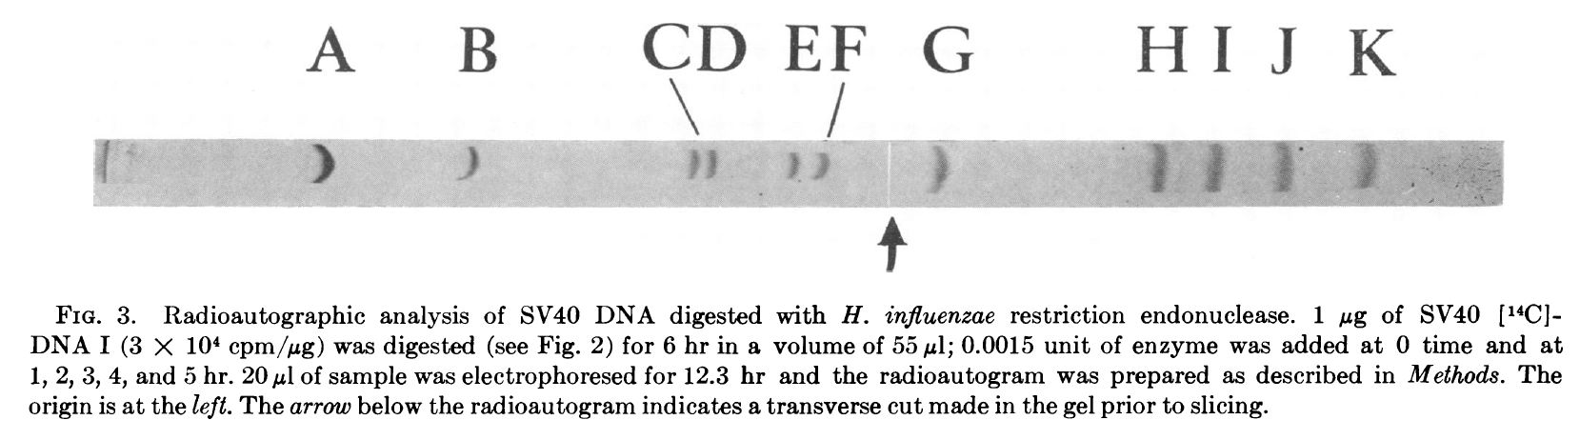
AHA!
Danna, K., Nathans, D. (1971) Specific cleavage of simian virus 40 DNA by restriction endonuclease of Hemophilus influenza. Proc. Natl. Acad. Sci. USA 68: 2913-2917.

Slide 3
The First Restriction Enzymes at CSHL
1972 EcoRI from Herb Boyer
Endonuclease R from Ham Smith (now HindII and HindIII)
HpaI and HpaII discovered by Bill Sugden, Phil Sharp and Joe Sambrook
1973 Endonuclease Z (now HaeIII) from Clyde Hutchison
HaeII discovered by Jim Breitmeyer, Nina Tabachnik, Phyllis Myers and RJR
SmaI discovered by Carel Mulder
“The main aim of this [Nucleic Acid Chemistry] laboratory is to investigate the use of restriction endonucleases as tools in the field of nucleic acid sequence analysis.”
from the 1973 CSHL Annual Report

Slide 4
1974 – A Memorable Year!
17 new restriction enzymes found including AluI, HhaI, MboI, MboII, SalI
EMBO Workshop on Restriction Enzymes and DNA sequencing
May 20-24, Ghent, Belgium
Organized by Walter Fiers, Jeff Schell and Marc Van Montagu
79 listed participants
The first Restriction Enzyme list – the precursor of REBASE

Slide 5
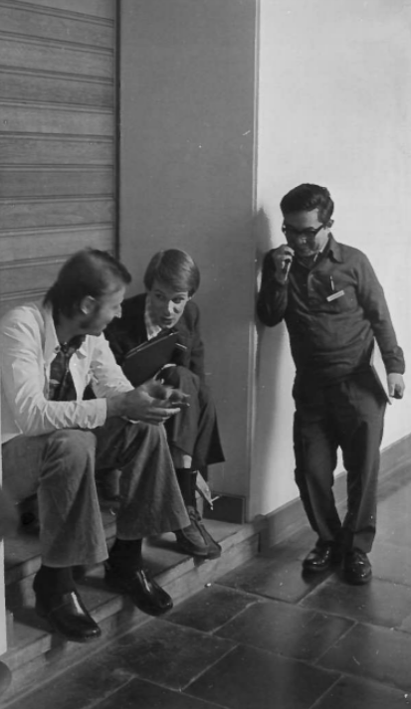
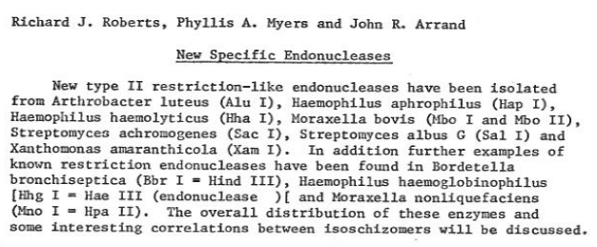
Ghent 1974

Slide 6
More new restriction enzymes – total reached 75 in 1975 and 100 in 1976
First publications:
Roberts, R.J., Breitmeyer, J.B., Tabachnik, N.F. and Myers, P.A. (1975) A second specific endonuclease from Haemophilus aegyptius. J. Mol. Biol. 91: 121-123.
Sugden, B., DeTroy, B., Roberts, R.J. and Sambrook, J. (1975) Agarose slab gel electrophoresis equipment. Anal. Biochem. 68: 36-46.
Roberts, R.J., Myers, P.A., Morrison, A. and Murray, K. (1976) A new specific endonuclease from Arthrobacter luteus. J. Mol. Biol. 102: 157-165.
Roberts, R.J., Myers, P.A., Morrison, A. and Murray, K. (1976) A specific endonuclease from Haemophilus haemolyticus. J. Mol. Biol. 103: 199-208.
Roberts, R.J. (1976) Restriction and modification enzymes and their recognition sequences. In Handbook of Biochemistry and Molecular Biology, 3rd Edition, Nucleic Acids. Vol. II. 532-535.
Roberts, R.J. (1976) Restriction endonucleases. CRC Critical Reviews in Biochemistry, 4: 123-164.
The first NEB catalog
1975 -1976

Slide 7

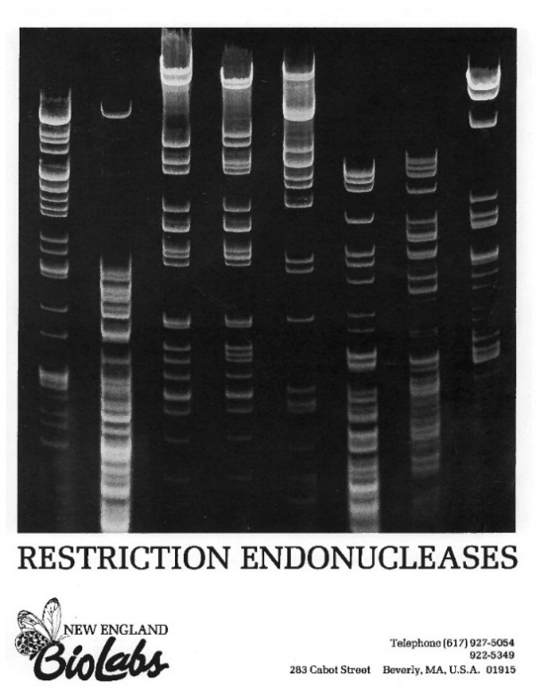
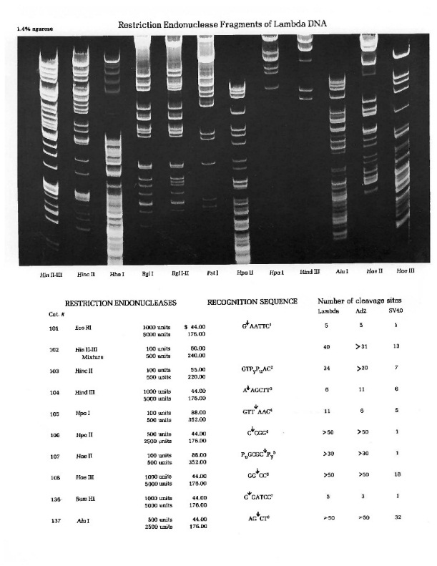
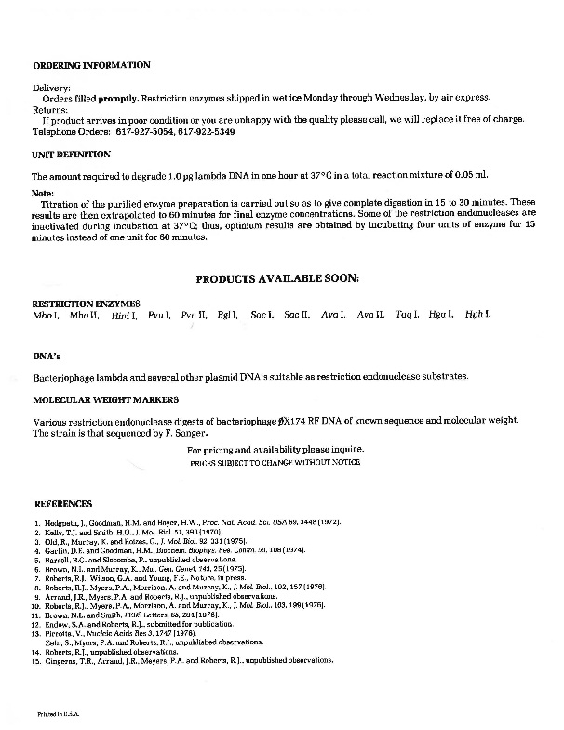
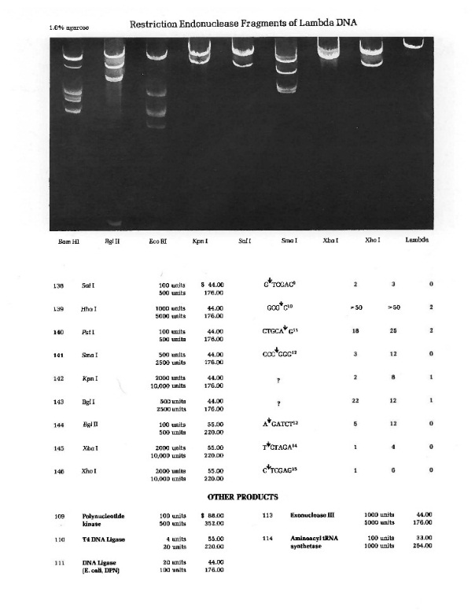
SalI AluI HhaI PstI SmaI KpnI BglI BglII XbaI XhoI
EcoRI HincII HindII HpaI HpaII HaeII HaeIII BamHI

Slide 8
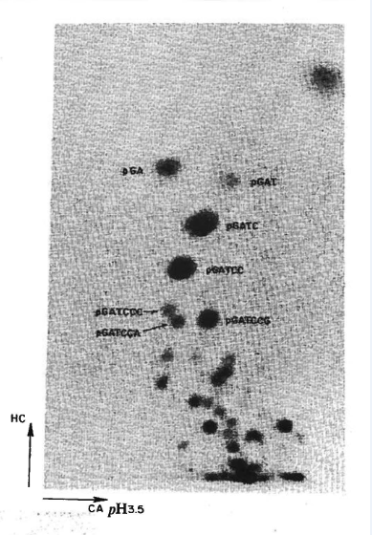
³²pGATCC
1977 – A Very Good Year!
Roberts, R.J., Wilson, G.A. and Young, F.E. (1977) Recognition sequence of specific endonuclease BamHI from Bacillus amyloliquefaciens H. Nature 265: 82-84.
4 new RE papers in J. Mol. Biol. describing
BalI, MboI, MboII, XbaI, XmaI
Chow, L.T., Gelinas, R.E., Broker, T.R. and Roberts, R.J. (1977) An amazing sequence arrangement at the 5' ends of adenovirus 2 messenger RNA. Cell 12: 1-8.
³²pGATCC

Slide 9
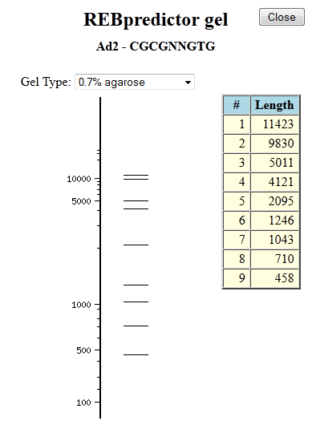
Computer Methods (1)
Gingeras, T.R., Milazzo, J.P. and Roberts, R.J. (1978) A computer assisted method for the determination of restriction enzyme recognition sites. Nucl. Acids Res. 5: 4105-4127. The precursor of REBpredictor.

Slide 10
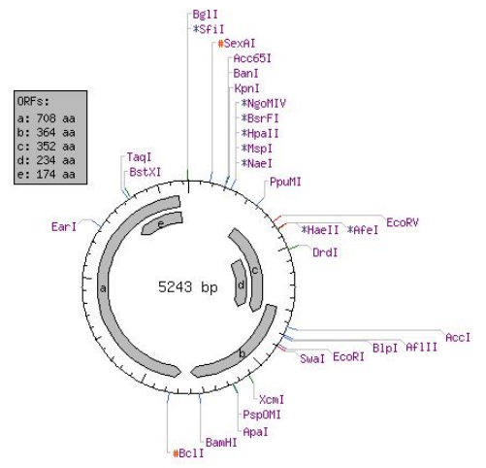
Computer Methods (2)
SV40
Blumenthal, R.M., Rice, P.R. and Roberts, R.J. (1982) Computer programs for nucleic acid sequence manipulation. Nucl. Acids Res. 10: 91-101.
CUTTER (finds restriction enzyme sites)
MUTATE (finds altered sites)
REMAP (displays restriction maps)
Vincze, T., Posfai, J., Roberts, R.J. (2003) NEBcutter.
Nucl. Acids Res. 31: 3688-3691.

Slide 11
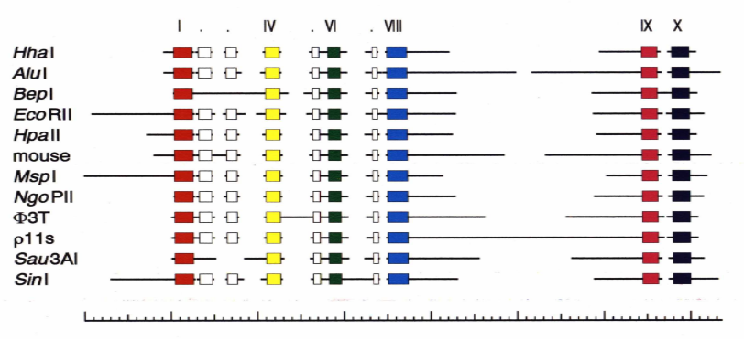
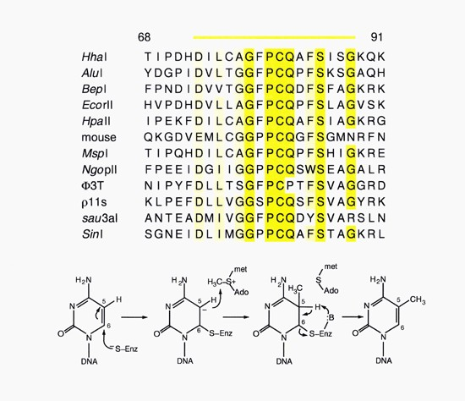
Computer Methods (3)
Posfai, J., Bhagwat, A.S. and Roberts, R.J. (1988) Sequence motifs specific for cytosine methytransferases. Gene 74: 261-265.
Pósfai, J., Bhagwat, A.S., Pósfai, G. and Roberts, R.J. (1989) Predictive motifs derived from cytosine methyltransferases. Nucleic Acids Res. 17: 2421-2435.

Slide 12
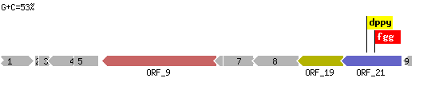
Computer Methods (4)
1992 – present
SEQWARE J. Posfai T. Vincze, R.J. Roberts
RM discovery system

Slide 13
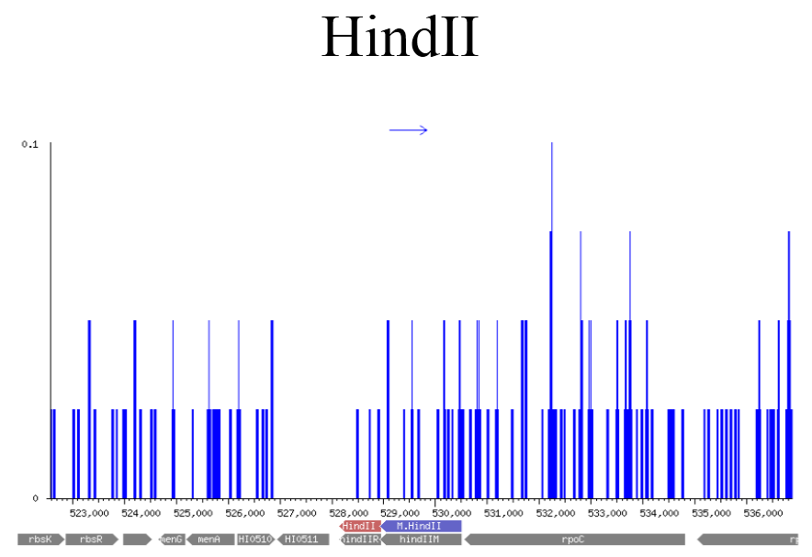
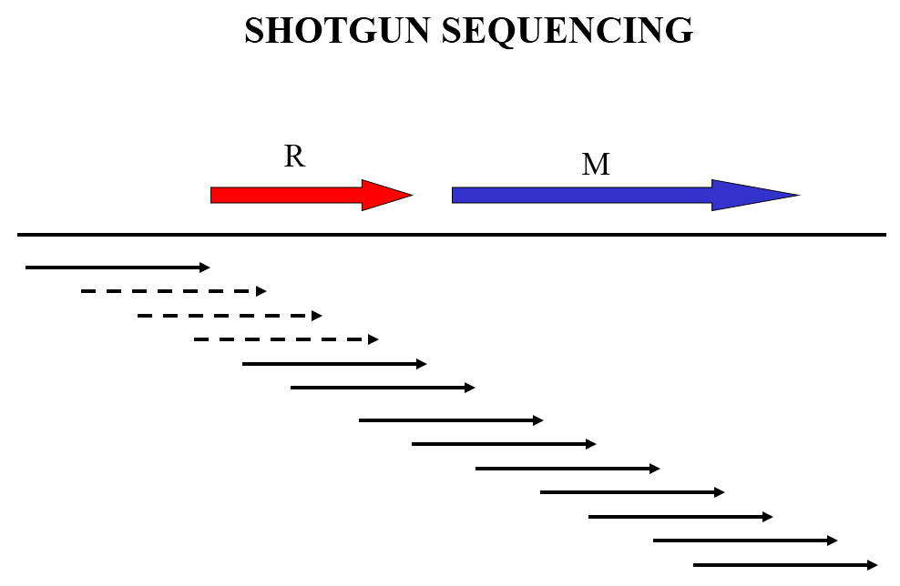
Computer Methods (5)
Zheng, Y., Posfai, J., Morgan, R.D., Vincze, T. and Roberts, R.J. (2009) Using Shotgun Sequence Data to find Active Restriction Enzyme Genes. Nucleic Acids Research 37: e1.

Slide 14
RE List becomes REBASE
1974 RE List drawn up for the Ghent Meeting (2 pages)
1st publication - Handbook of Biochemistry and Molecular Biology
1st “real” publication – Gene 4: 183-193
1st publication in Nucl. Acids Res. 8: r63-r80
1993: Roberts, R.J. and Macelis, D. REBASE—restriction enzymes and methylases. Nucl. Acids Res. 21: 3125-3137.
REBASE web site started Mar 21 1994
2010 Nucl. Acids Res. 38: D234-D236.

Slide 15
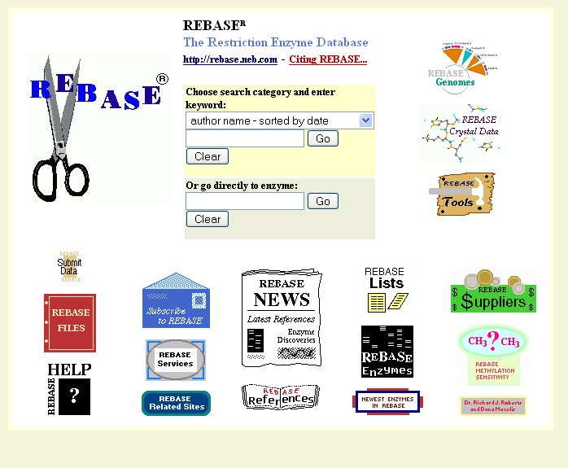
rebase.neb.com/rebase/rebase.html

Slide 16
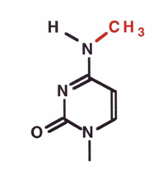
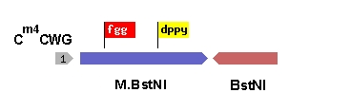
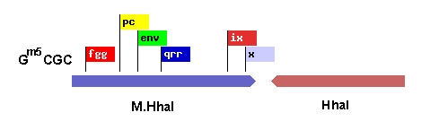
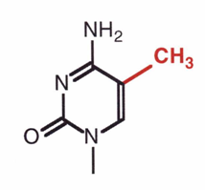
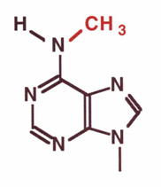
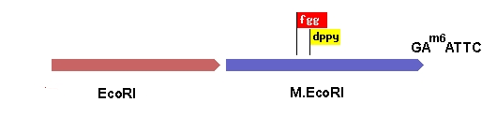
DNA methylases – bosom pals of restriction enzymes

Slide 17
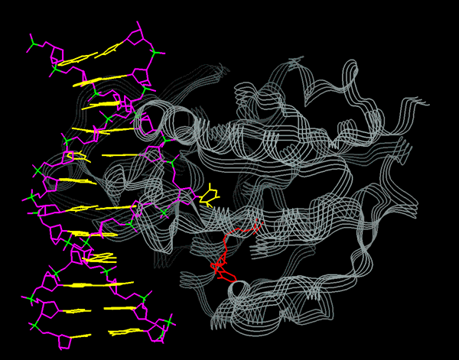
Klimasauskas, S., Kumar, S., Roberts, R.J. and Cheng, X. (1994) HhaI methyltransferase flips its target base out of the DNA helix. Cell 76: 357-369

Slide 18
SMRT sequencing from Pacific Biosciences
Real-time DNA sequencing from single polymerase molecules.
Eid, J et al. Science. (2009) 323 133-138
Direct detection of DNA methylation during single-molecule, real-time sequencing.
Flusberg, B.A et al. Nat. Methods (2010) 7 7461-7465
Characterization of DNA methyltransferase specificities using single-molecule, real-time DNA sequencing.
Clark, T.A. et al. Nucleic Acids Res. (2012) 40 e29

Slide 19
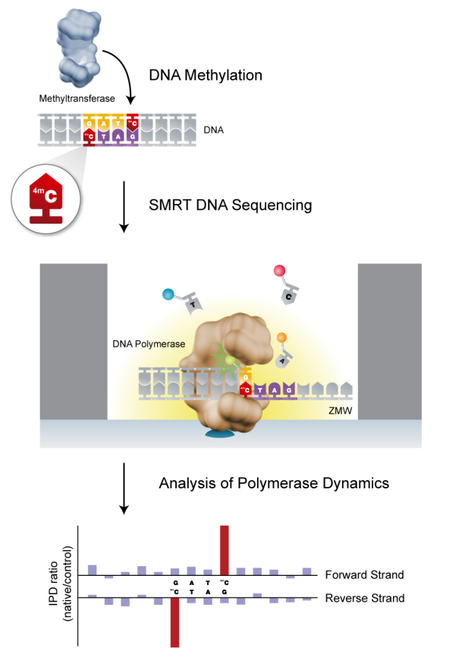
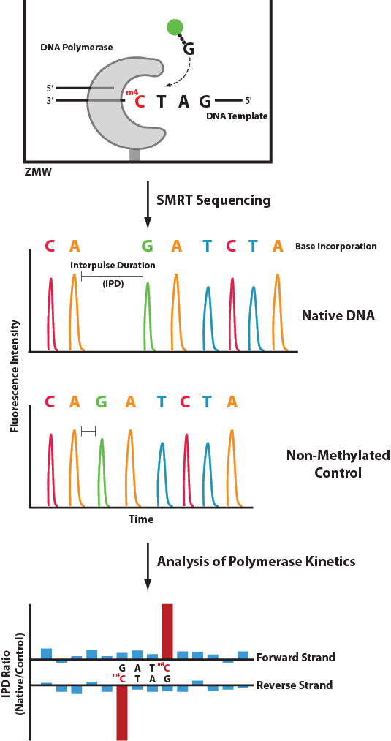

Slide 20
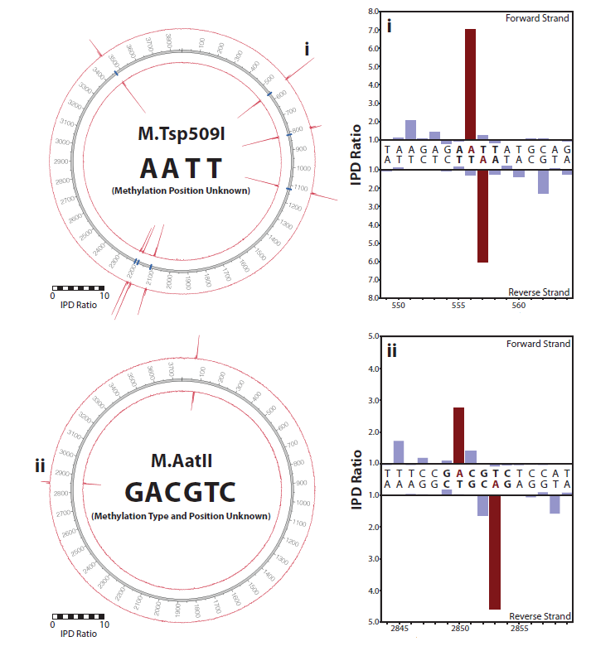
Two unknown methylation sites
Clark et al. Nucleic Acids Res. (2012) 40: e29

Slide 21
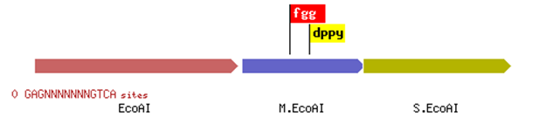

Type I and III RM Systems
I
III

Slide 22
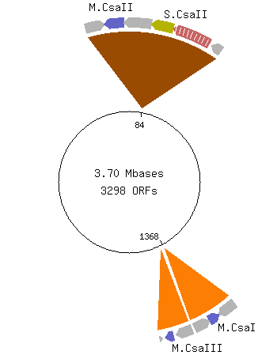
Chromohalobacter salexigens
Motif | # in Genome | # Detected as Methylated | Detected
5’-RGATCY-3’ 3’-YCTAGR-5’ | 5,084 | 3,890 | 76.5 %
5’-CCACN₆CTC-3’ 3’-GGTGN₆GAG-5’ | 785 785 | 772 759 | 98.3 % 96.7 %
M.CsaI
M.CsaII
M.CsaIII – relatively non-specific - ^{m6}AB
prophage-encoded
Murray, I.A. Nucleic Acids Res. (2012) 40 11450

Slide 23
Six Complete Genomes
predicted RM systems
I II III
Chromohalobacter salexigens 1 2
Geobacter metallireducens GS-15 2 1
Vibrio breoganii 1C-10 2 1
Campylobacter jejuni 81-176 2 3
Campylobacter jejuni NCTC 11168 1 3
Bacillus cereus ATCC 10987 2 6 1
27 methyltransferases
13 new specificities
Murray, I.A. Nucleic Acids Res. (2012) 40 11450

Slide 24
Type I and III Methyltransferase characterization

