Slide 1
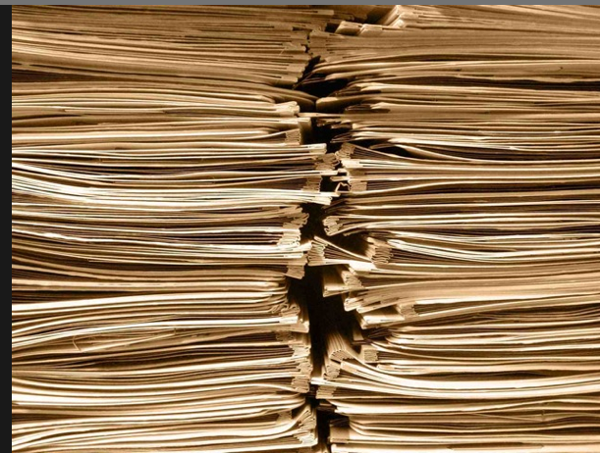
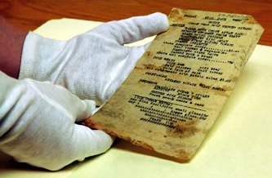
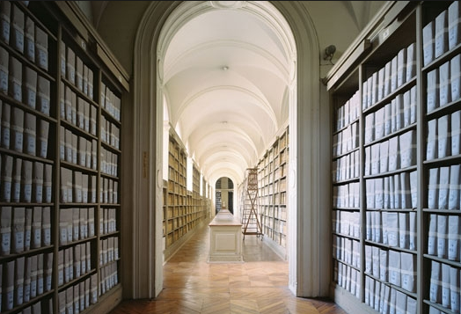
Illuminating the History of Science
The importance of Historical Archives
Mila Pollock
History of Restriction Enzymes Meeting,
CSHL, October 19-21, 2013
Notes:
A fundamental part of the process of academic scientists is to share your results with public, with the rest of the world
The purpose of archives is to collect original materials about the major work of the scientists.
So historian and others can use it to analyze a field in whole, to write books about fields scientists and their work.
Multimedia is coming to present all of these in the documentaries, movies, online websites etc,
The NWT Archives' primary task is to ensure that a fair, accurate and complete record of government activity is identified, acquired and preserved

Slide 2
Communicating Science
Researchers
Scientific talks
Posters
Correspondence/Emails
Scientific papers
Archives
Correspondence
Slides
Manuscripts
Reprints
Photos
Clippings
Data
Notes:
Your share your research

Slide 3
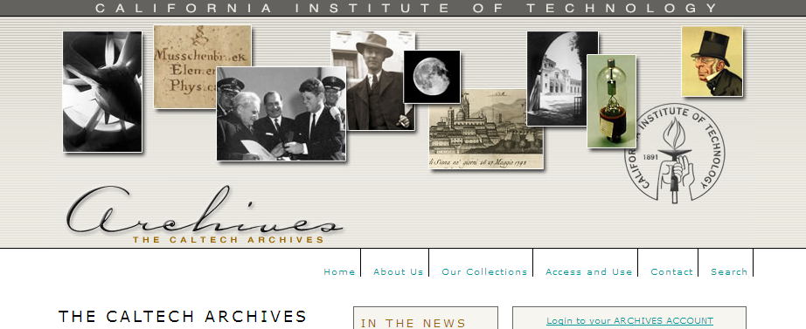
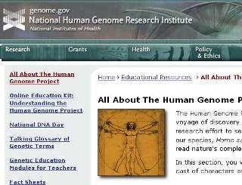
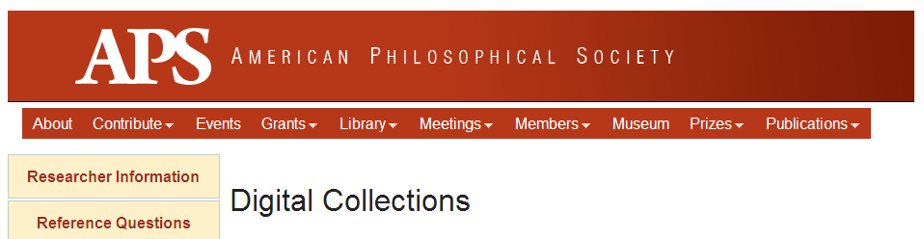
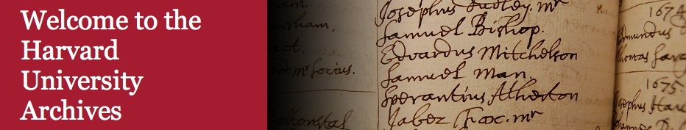
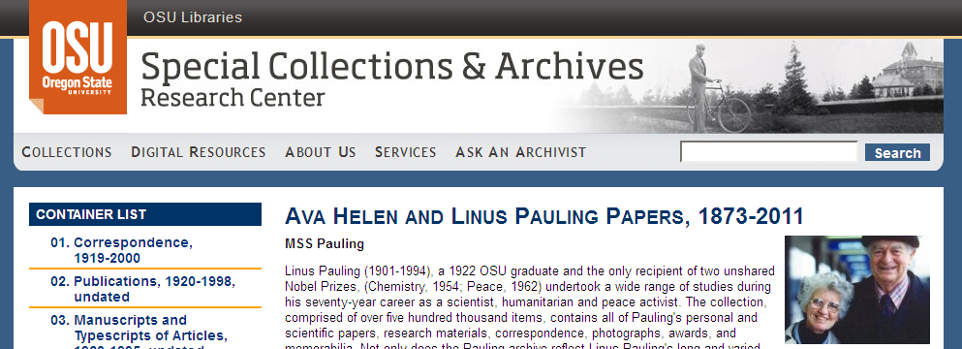
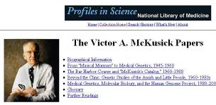
Notes:
Home pages of some of the repositories of papers which have been collected and digitized.
The homepage of the repository of the personal papers of the great scientis

Slide 4
Collections on Special Subjects
American Institute of Physics
American Philosophical Society
The Wellcome Trust Library (history of medicine)
College of Physicians (historical medical library)
Chemical Heritage Foundation
Berkeley Program in Bioscience and Biotechnology Studies
Life Sciences Foundation (history of biotechnology)
CSHL Archives and the Genentech Center for the History of Molecular Biology, and Biotechnology
Mila Pollock
History of Restriction Enzymes Meeting,
CSHL, October 19-21, 2013
Notes:
Archives are not storage , they tell history . I chose a few to highlight here

Slide 5
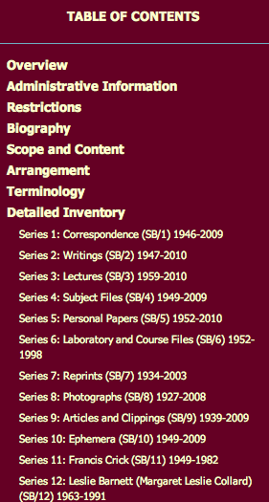
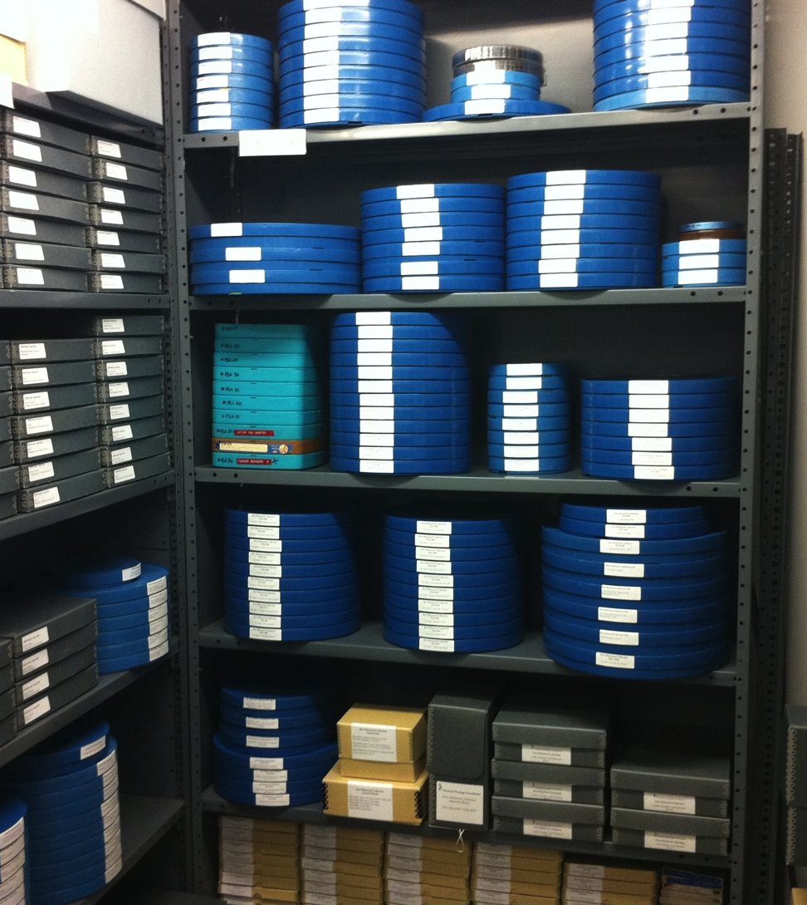
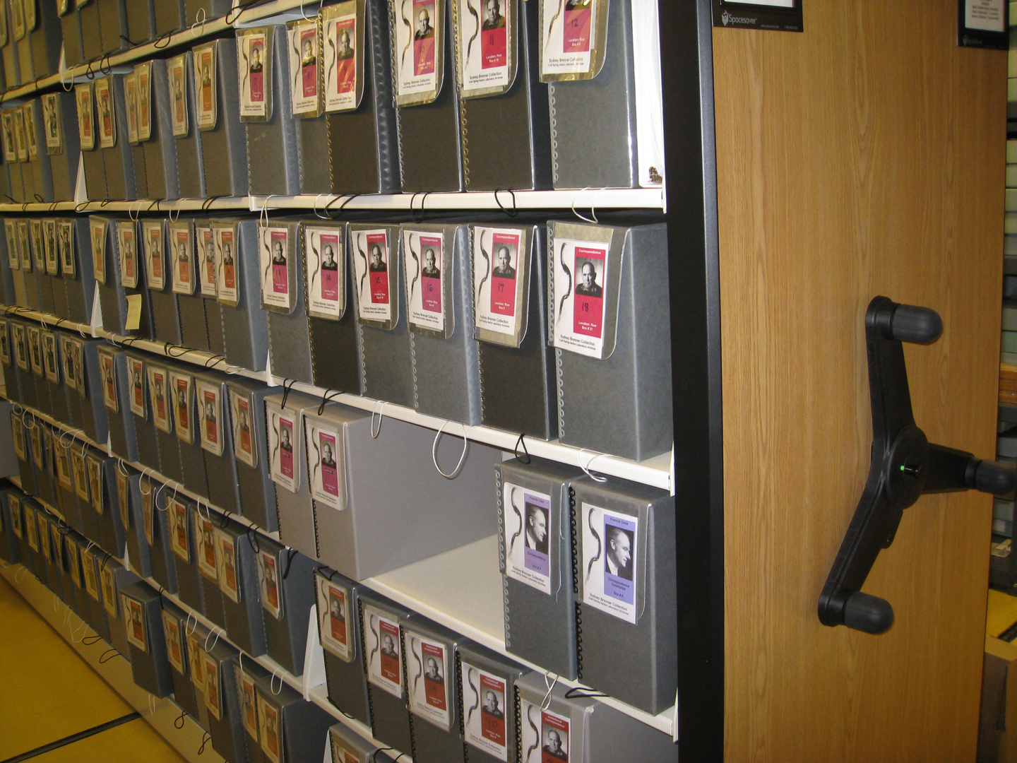
How New Collections are Handled
A New Collection is processed
in four steps:
1. Collection is surveyed
2. Organized in folders boxes
3. Finding aids are created
4. Collection is digitized
5. Metadata is assigned
(folder or item level)
Materials are ready for scholars, researchers and other users
Notes:
Ideally this is the way each archives would process their new collecting from beginning to the end but not all institution can go so far. We still depend on support of such projects.

Slide 6
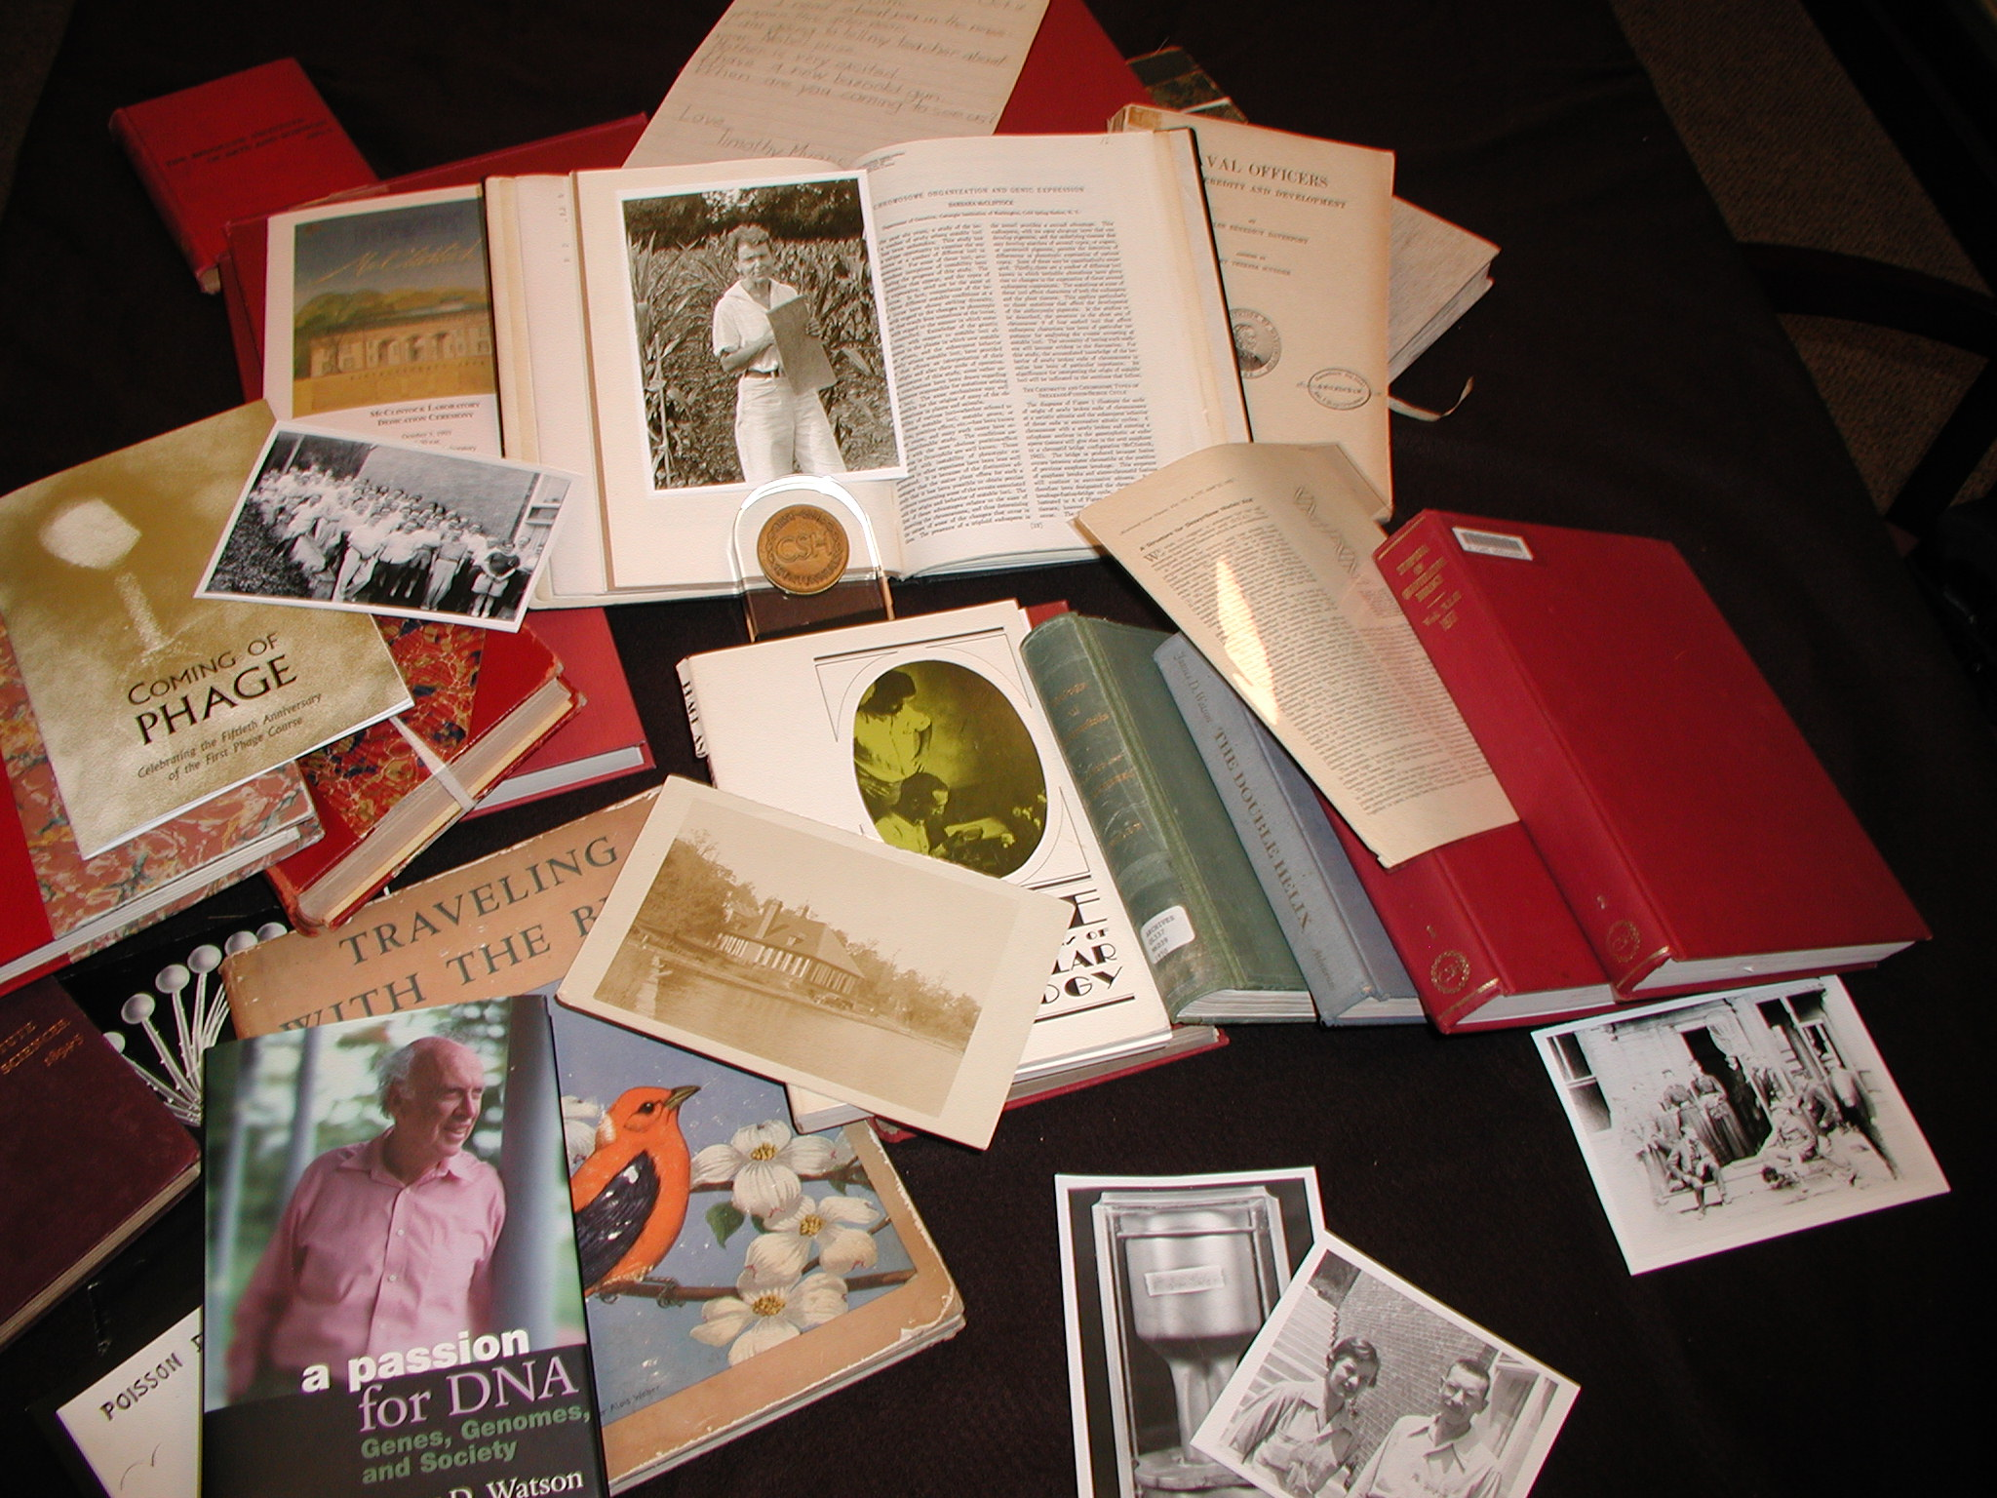
Cold Spring Harbor Laboratory Archives and
Genentech Center for the History of Molecular Biology and Biotechnology.
Types of documents:
Correspondence
Manuscripts
Lab Notes
Photographs &
Slides
Reprints
Maps
Video/audio tapes
Books in Genetics
The archives and the center contains 74 sub-collections (~1450 linear feet)
of original documents and reprints.
Books: 3,950 (from 1900 -)
Reprints: 68,000 (1890- )
Photos: 80,000 (from 1934-)
Oral history interviews 175
Notes:
The Library and Archives, is located in the Carnegie Building, built in 1905 with the support of the Carnegie Institute of Washington. The Archives, created in 1972, houses the growing collection of research and historical materials, consisting of a rich repository of rare books, manuscripts, photographs, personal correspondence, and scientific reprints related to CSHL.
Today our archives houses collections including correspondence, manuscripts, lab notes, photographs and slides, and reprints as well as maps and books in genetics. The personal collections now at CSHL are the collections of Barbara McClintock, Charles Davenport, Hugo Fricke, Reginald and Jane (Davenport) Harris, Alfred Hershey, Hermann Muller and James Watson. Mila noted that we will be acquiring the papers of Sydney Brenner and plan to digitize them as well as the collections of others. Sydney is pleased that his collection has found a home at CSHL. He will then be able to access his own collection without having to store it.
The CSHL Archives houses the Laboratory Records and other materials of the Eugenics Records Office and the Biological Laboratory courses (1889-1923.) It also holds the Carnegie Department of Genetics reprint collection, the Audio/Video Collection, the Photo Collection (1898-present) and the Map Collection.

Slide 7
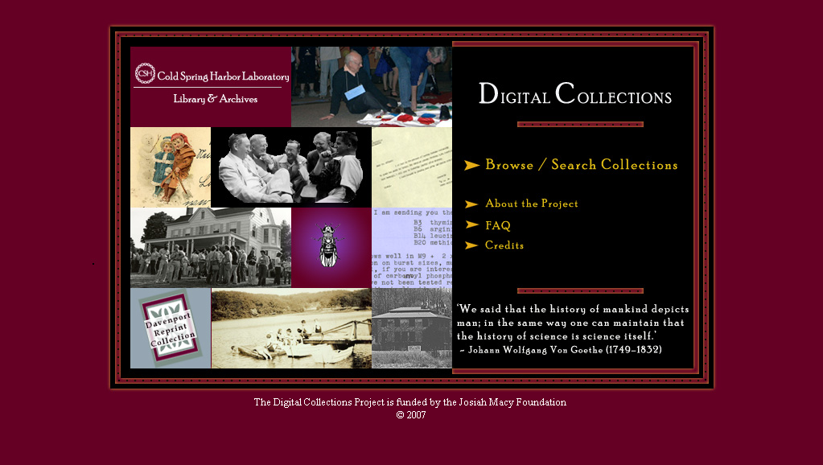
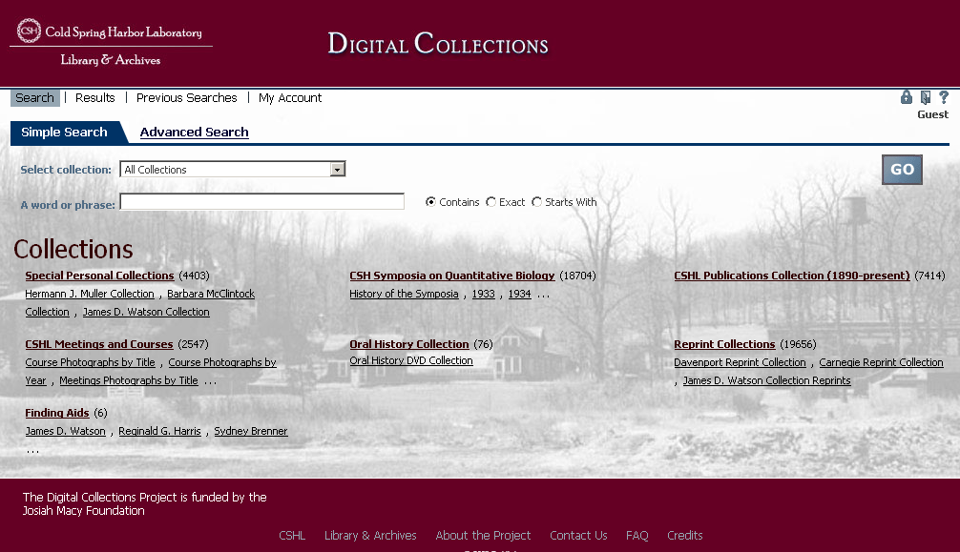
CSHL Archives Digital project
Notes:
A wealth of primary sources – over hundred letters, manuscripts, photographs, published papers, audio-visual snippets and more - provide an important scholarly perspective on the molecular biology different stories

Slide 8
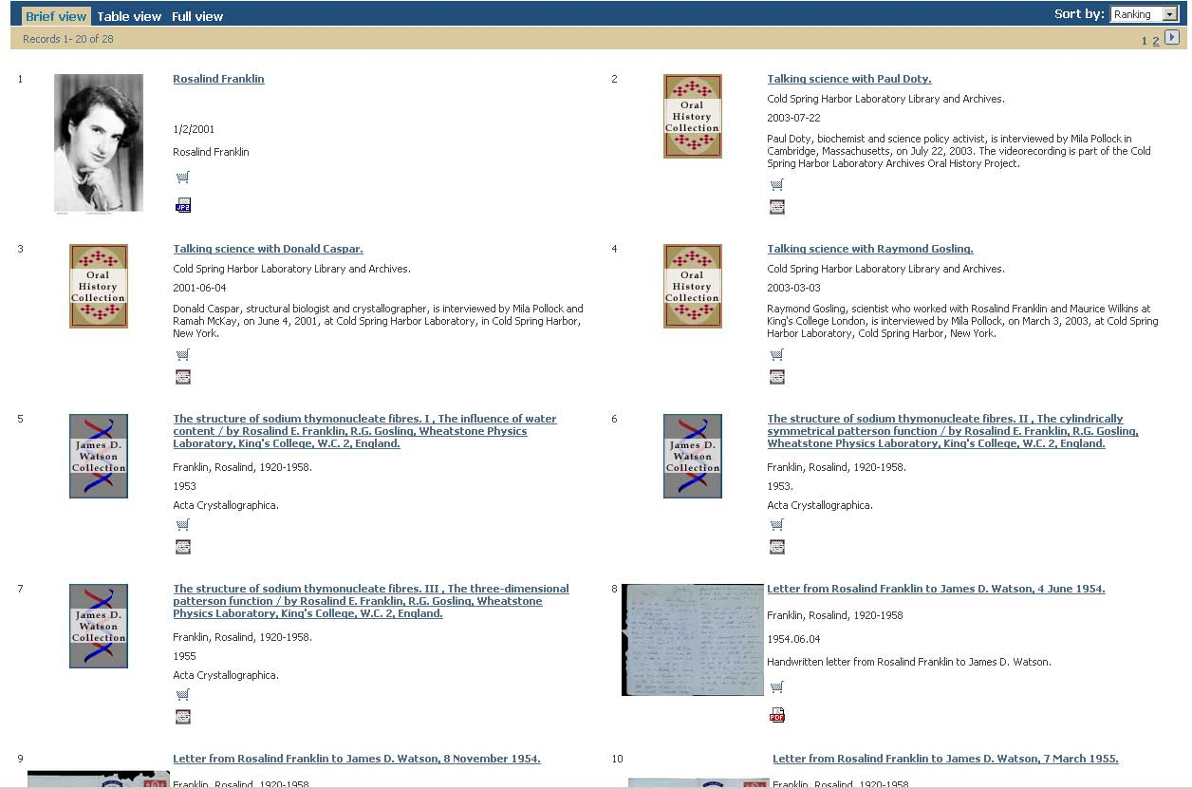
Retrieved Records on Rosalind Franklin

Slide 9
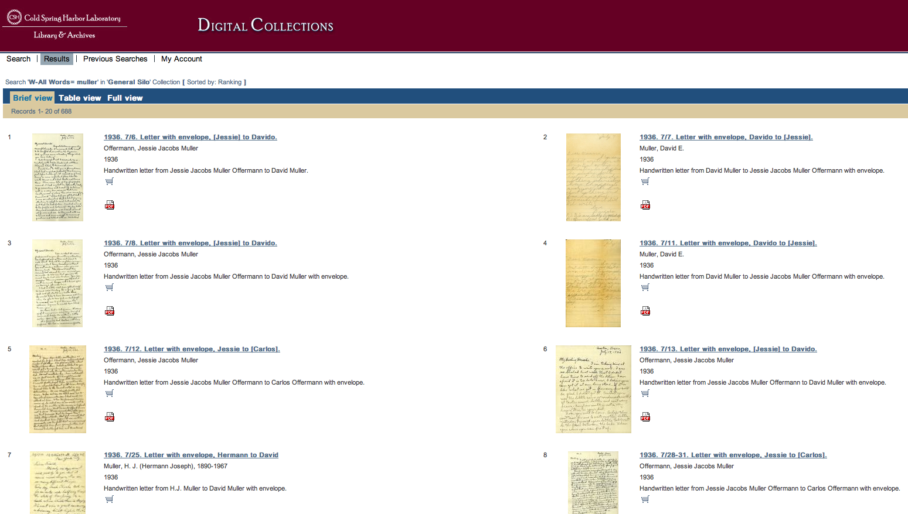
From Herman Muller Collection
Mila Pollock
History of Restriction Enzymes Meeting,
CSHL, October 19-21, 2013

Slide 10
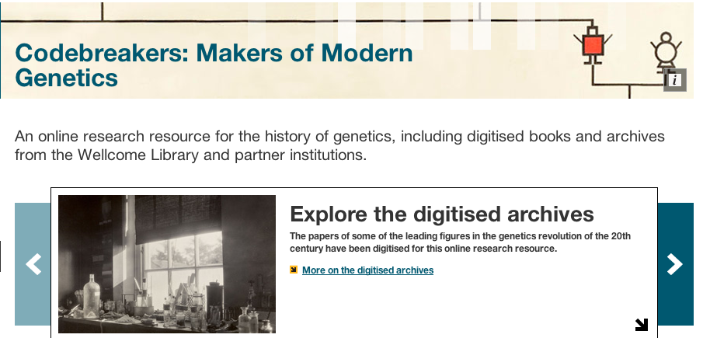
Selected collections for this project:
The Carlos Paton Blacker papers
The Sydney Brenner papers
The Francis Crick papers
The Eugenics Society papers
The Honor Fell papers
The Malcolm Ferguson-Smith papers
The Rosalind Franklin papers
The Hans Grüneberg papers
The J B S Haldane papers
The Peter Medawar papers
The Medical Research Council Blood
Group Unit archive
The Arthur Mourant papers
The Lionel Penrose papers
The Guido Pontecorvo papers
The Robert Race and Ruth Sanger
papers
The James Renwick papers
The Frederick Sanger papers
The James Watson papers
Maurice Wilkins and Medical Research
Council Biophysics Unit archive
The Gerard Wyatt papers
Archives of 20 eminent geneticists, medical researchers
and organizations.
You can read more than 2.5 million images of diaries,
notebooks, case studies, correspondence, research
papers and published books online.
Institutions involved with the project:
The Wellcome Library
Churchill Archives Centre, Cambridge
Cold Spring Harbor Laboratories
University of Glasgow
Kings College London
University College London
Notes:
This digitization project aimed to create an online research resource for the history of genetics .

Slide 11
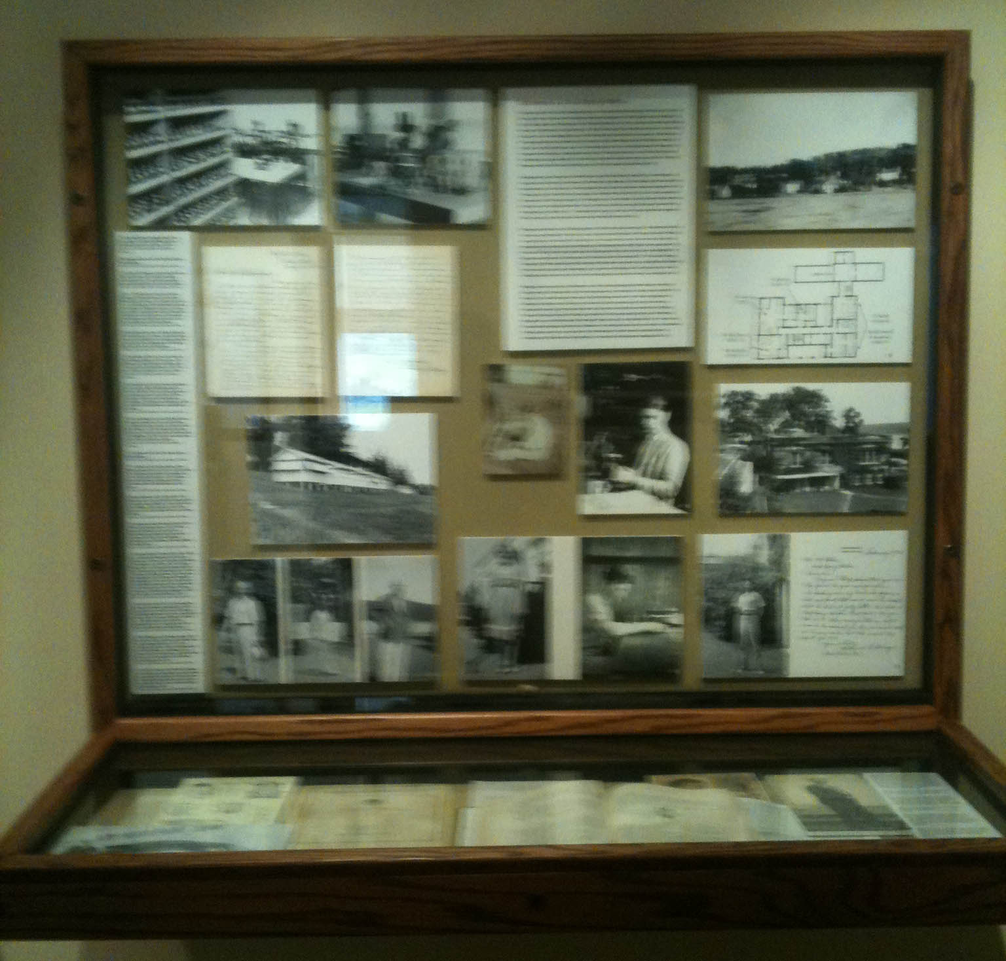
CSHL Archives in Use
Selected Documentaries:
The Fly Room, Imagine Science Films, 2013
Biography of the Year, A&E, 2000
The Genetic Journey, PBS, 2000
Selected Exhibitions:
Norton Zinder Exhibit (The Rockefeller University), 2013
Alfred D. Hershey Exhibitions (Hershey Building) Ongoing
Calvin Bridges: Unconventional Geneticist (Carnegie Library), 2012-2013
75 Years of the CSH Symposia, 2012-2013
Science at Cold Spring Harbor: The Age of Genetics (1904-1972),
Cultures of Creativity. The Centennial Exhibition of the Nobel Prize, 1901- 2007
Our Expanding Universe: Celebrating a Century of Carnegie Science, 2002
Selected books:
Genius in the Shadows: A biography of Leo Szilard,
the Man Behind the Bomb, 2013
The Annotated and Illustrated Double Helix, 2012
Sydney Brenner: A Biography, 2010
Francis Crick: Hunter of Life’s Secrets, 2009
DNA: The Secret of Life, 2003
The Eighth Day of Creation: Makers of the Revolution
in Biology, Expanded edition, 1996
The Early Days of Yeast Genetics, 1993
The Path to The Double Helix: Discovery of DNA, 1974

Slide 12
Sydney Brenner Research Scholarship
At CSHL
Recipients 2006-2012
2012-13 Gregory Morgan Book: Cancer Virus Hunters (in progress)
2011-12 Judith Cuddihy Exhibition and documentary: Calvin Bridges: Unconventional Geneticist
2008-09 Marsha Richmond Book: The Role of Women in Genetics Research in the Early 20th Century (in progress)
2007-08 James Schwartz Book: In Pursuit of the Gene: From Darwin to DNA, published 2009. Includes the life and work of
Hermann Muller
2006-07 Robert Olby Book: Francis Crick: Hunter of Life’s Secrets,
published 2009
Mila Pollock
History of Restriction Enzymes Meeting,
CSHL, October 19-21, 2013

Slide 14
