Slide 1


Alfred Pingoud
CSHL
Oct. 19-21 2013
The History of Restriction Enzymes“
„Sequence specific recognition and engineering“

Slide 2
roberts@neb.com Sa 03.08.2013
Outline of talks
Alfred Pingoud (25 mins):
EcoRI mutagenesis and insights into sequence specific recognition.
Sequence specific recognition and the value of mutagenesis to study function.
Engineering restriction enzymes to change specificity.
A survey of other work such as fusion of the FokI cleavage domain to various other sequence-specific binding proteins.

Slide 3
How it all started
Smith H, Wilcox KW
A Restriction enzyme from Hemophilus influenzae *1I. Purification and general properties.
J Mol Biol. 1970; 51:379
Hedgpeth J, Goodman HM, Boyer HW.
DNA nucleotide sequence restricted by the RI endonuclease.
Proc Natl Acad Sci U S A. 1972;69:3448.
Greene PH, Poonian MS, Nussbaum AL, Tobias L, Garfin DE, Boyer HW, Goodman HM.
Restriction and modification of a self-complementary octanucleotide containing the EcoRI substrate.
J Mol Biol. 1975;99:237
Modrich P, Zabel D.
EcoRI endonuclease. Physical and catalytic properties of the homogenous enzyme.
J Biol Chem. 1976;251:5866.

Slide 4
Binding and cleavage experiments
Goppelt M, Pingoud A, Maass G, Mayer H, Köster H, Frank R.
The interaction of EcoRI with its substrate. A physico-chemical study employing natural and synthetic oligonucleotides and polynucleotides.
Eur J Biochem. 1980;104101
EcoRI binds to ss and ds poly-ribonucleotides and poly-deoxyribonucleotides. Mg²⁺ ions are not required for binding.
The binding of d(GGAATTCC) to EcoRI is strengthened by two orders of magnitude in the presence of Mg²⁺ ions
Langowski J, Urbanke C, Pingoud A, Maass G.
Transient cleavage kinetics of EcoRI measured in a pulsed quench-flow apparatus: enzyme concentration-dependent activity change.
Nucleic Acids Res. 1981;9:3483.
The catalytic constants for cleavage of the first and second strand have the same value of 0.35 sec⁻¹ at 21°C

Slide 5
Probing the protein-DNA interface I
With synthetic oligonucleotides containing modified bases structural elements required for the recognition process were identified.
Fliess A, Wolfes H, Rosenthal A, Schwellnus K, Blöcker H, Frank R, Pingoud A.
Role of thymidine residues in DNA recognition by the EcoRI and EcoRV restriction endonucleases.
Nucleic Acids Res. 1986;14:3463
Similar experiments showed, that the isoschizomers HaeIII, BspRI and BsuRI have different substrate requirements.
Wolfes H, Fliess A, Pingoud A.
A comparison of the structural requirements for DNA cleavage by the isoschizomers HaeIII, BspRI and BsuRI.
Eur J Biochem. 1985;150:105

Slide 6
Probing the protein-DNA interface II
A BrdU containing oligonucleotide could be cross-linked to Met-137 in EcoRI, thereby identifying a base-specific contact
Wolfes H, Fliess A, Winkler F, Pingoud A.
Cross-linking of bromodeoxyuridine-substituted oligonucleotides to the EcoRI and EcoRV restriction endonucleases.
Eur J Biochem. 1986;159:267.
With similar cross-linking techniques and mutagenesis, which identified base specific contacts, the evolutionary relationship between SsoII, PspGI and MboI, which share little sequence homology, could be deduced

Slide 7
Probing the protein-DNA interface III
Thielking V, Alves J, Fliess A, Maass G, Pingoud A.
Accuracy of the EcoRI restriction endonuclease: binding and cleavage studies with oligodeoxynucleotide substrates containing degenerate recognition sequences.
Biochemistry. 1990;29:4682.
The probability of EcoRI making mistakes in cleaving DNA not only in its recognition sequence but also in sequences closely related to it was determined with 18 degenerate substrates. Due to the fact that the rates of cleavage in the two strands of a degenerate sequence generally are widely different, these mistakes are most likely not occurring in vivo, since nicked intermediates can be repaired by DNA ligase.

Slide 8
Probing the protein-DNA interface IV
Ehbrecht HJ, Pingoud A, Urbanke C, Maass G, Gualerzi C.
Linear diffusion of restriction endonucleases on DNA.
J Biol Chem. 1985;2606:160.
Jeltsch A, Alves J, Wolfes H, Maass G, Pingoud A.
Pausing of the restriction endonuclease EcoRI during linear diffusion on DNA.
Biochemistry. 1994:102.
Jeltsch A, Wenz C, Stahl F, Pingoud A.
Linear diffusion of the restriction endonuclease EcoRV on
DNA is essential for the in vivo function of the enzyme.
EMBO J. 1996;15:5104.
EcoRI, HindIII, and BamHI
Linear diffusion is critically dependent on contacts between aminoacid side chains of the protein and the backbone of the DNA. Changing the centrosymmetric electrostatic potential in the DNA binding site affects effective sliding and thereby phage restriction.

Slide 9
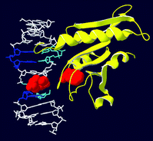
Probing the protein-DNA interface V
Pingoud V, Geyer H, Geyer R, Kubareva E,
Bujnicki JM, Pingoud A.
Identification of base-specific contacts in protein-DNA complexes by photocrosslinking and mass spectrometry: a case study using the restriction endonuclease SsoII.
Mol Biosyst. 2005 1:135.
The structure of restriction enzyme-substrate complexes were modelled using multiple sequence alignments, X-linking and SDM

Slide 10
Resolving mechanistic details
With the help of phosphorothioate-substituted oligonucleotides the stereochemical course of phosphodiester bond hydrolysis could be clarified – the hydrolysis reaction catalyzed by EcoRI proceeds with inversion of configuration at phosphorus. This result is compatible with a direct enzyme-catalyzed nucleophilic attack of H₂O at phosphorus without involvement of a covalent enzyme intermediate.
Connolly BA, Eckstein F, Pingoud A.
The stereochemical course of the restriction endonuclease EcoRI-catalyzed reaction.
J Biol Chem. 1984;259:10760.

Slide 11
Cloning and overexpression of EcoRI
Botterman J, Zabeau M.
High-level production of the EcoRI endonuclease under the control of the pL promoter of bacteriophage lambda.
Gene. 1985;37:229.
made life much easier for biochemical studies
allowed carrying out site-directed mutagenesis
Hutchison CA, Phillips S, Edgell MH, Gillam S, Jahnke P, Smith M.
Mutagenesis at a specific position in a DNA sequence.
J Biol Chem. 1978;253:6551.

Slide 12
Crystal structure analyses
Kim YC, Grable JC, Love R, Greene PJ, Rosenberg JM.
Refinement of EcoRI endonuclease crystal structure: a revised protein chain tracing.
Science. 1990;249:1307-9.
Winkler FK, Banner DW, Oefner C, Tsernoglou D, Brown RS, Heathman SP, Bryan RK, Martin PD, Petratos K, Wilson KS.
The crystal structure of EcoRV endonuclease and of its complexes with cognate and non-cognate DNA fragments.
EMBO J. 1993;12:1781.

Slide 13
Catalysis I
Structure-guided mutagenesis followed by steady-state kinetic experiments allowed identifying amino acids involved in catalysis
Wolfes H, Alves J, Fliess A, Geiger R, Pingoud A.
Site directed mutagenesis experiments suggest that Glu 111, Glu 144 and Arg 145 are essential for endonucleolytic activity of EcoRI.
Nucleic Acids Res. 1986;14:9063
Thielking V, Selent U, Köhler E, Wolfes H, Pieper U, Geiger R, Urbanke C, Winkler FK, Pingoud A.
Site-directed mutagenesis studies with EcoRV (and EcoRI). restriction endonuclease to identify regions involved in recognition and catalysis.
Biochemistry. 1991;30:6416
Selent U, Rüter T, Köhler E, Liedtke M, Thielking V, Alves J, Oelgeschläger T, Wolfes H, Peters F, Pingoud A.
A site-directed mutagenesis study to identify amino acid residues involved in the catalytic function of the restriction endonuclease EcoRV (and EcoRI).
Biochemistry. 1992;31:4808-15.

Slide 14

Catalysis II
“…We suggest on the basis of structural information, muta-genesis data, and analogies with other nucleases that in EcoRV Asp74 and Asp90 might be involved in Mg²⁺ binding and/or catalysis and that Lys92 probably stabilizes the pentacovalent phosphorus in the transition state. These amino acids are part of a sequence motif, Pro-Asp...Asp/Glu-X-Lys, which is also present in EcoRI…” (Selent et al 1992)
The PD..D/E-X-K motif defines the largest family of enzymes among the Type II restriction enzymes

Slide 15
Catalysis III
Jeltsch A, Alves J, Maass G, Pingoud A.
On the catalytic mechanism of EcoRI and EcoRV. A detailed proposal based on biochemical results, structural data and molecular modelling.
FEBS Lett. 1992; 304:4

Slide 16
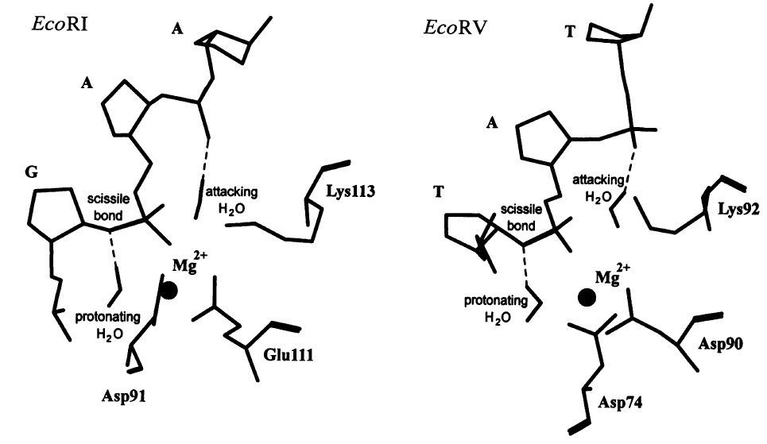
Catalysis IV
Jeltsch A, Alves J, Wolfes H, Maass G, Pingoud A.
Substrate-assisted catalysis in the cleavage of DNA by the EcoRI and EcoRV restriction enzymes.
Proc Natl Acad Sci U S A. 1993;90:8499.

Slide 17
Catalysis V
“The detailed mechanism of DNA hydrolysis by enzymes is of significant current interest. One of the most important questions in this respect is the catalytic role of metal ions such as Mg²⁺. While it is clear that divalent ions play a major role in DNA hydrolysis, it is uncertain what function such cations have in hydrolysis and why two are needed in some cases and only one in others”
Fothergill M, Goodman MF, Petruska J and Warshel A
J. Am. Chem. Soc. 1995; 117: 11619

Slide 18
Catalysis VI
Pingoud V, Wende W, Friedhoff P, Reuter M, Alves J, Jeltsch A, Mones L, Fuxreiter M, Pingoud A.
On the divalent metal ion dependence of DNA cleavage by restriction endonucleases of the EcoRI family. BamHI, BglII, Cfr10I, EcoRI, EcoRII,
J Mol Biol. 2009;393:140 MboI, NgoMIV, PspGI, and SsoII
Type II restriction endonucleases in general have two Me²⁺ binding sites per active centre.
One high affinity binding site (site A), where a Mg²⁺ or Mn²⁺ ion is required for cleavage and another low affinity binding site (site B), being inhibitory when occupied by Mg²⁺ or Mn²⁺, or stimulatory when occupied by Ca²⁺.
Dupureur CM.
One is enough: insights into the two-metal ion nuclease mechanism from global analysis and computational studies.
Metallomics. 2010;2:609

Slide 19
Evolution of restriction enzymes I
The type-II ENases, in contrast, except for some homologous isoschizomers, do not share significant aa sequence similarity. Therefore, ENases in general have been considered unrelated.
The analysis of the genotype (aa sequence) and of the phenotype (recognition sequence) demonstrate that the recognition sequences of those ENases, which were found to be related by a multiple aa sequence alignment, are more similar to each other than would be expected by chance. This analysis supports the notion that type-II ENases did not arise independently in evolution, but rather evolved from one or a few primordial DNA-cleaving enzymes.
Jeltsch A, Kröger M, Pingoud A.
Evidence for an evolutionary relationship among type-II restriction endonucleases.
Gene. 1995;160:7.

Slide 20
Evolution of restriction enzymes II
Type IIP, type IIE, and type IIF do not represent separate branches on the evolutionary tree of restriction enzymes
Pingoud V, Kubareva E, Stengel G, Friedhoff P, Bujnicki JM, Urbanke C, Sudina A, Pingoud A.
Evolutionary relationship between different subgroups of restriction endonucleases.
J Biol Chem. 2002;277:14306.
Specifities for unrelated sequences could evolve on the same structural frame work: CCNGG,CCWGG,GCCGGC,RCCGGY,GATC
Pingoud V, Sudina A, Geyer H, Bujnicki JM, Lurz R, Lüder G, Morgan R, Kubareva E, Pingoud A.
Specificity changes in the evolution of type II restriction endonucleases: a biochemical and bioinformatic analysis of restriction enzymes that recognize unrelated sequences.
J Biol Chem. 2005;280:4289
IIP: SsoII; IIE: EcoRII; IIF: NgoMIV
SsoII, PspGI, EcoRII, NgoMIV, Cfr10I, MboII

Slide 21
Protein engineering of EcoRV I
Lanio T, Selent U, Wenz C, Wende W, Schulz A, Adiraj M, Katti SB, Pingoud A.
EcoRV-T94V: a mutant restriction endonuclease with an altered substrate specificity towards modified oligodeoxynucleotides.
Protein Eng. 1996;9:1005
Wenz C, Hahn M, Pingoud A.
Engineering of variants of the restriction endonuclease EcoRV that depend in their cleavage activity on the flexibility of sequences flanking the recognition site.
Biochemistry. 1998;37:2234
Lanio T, Jeltsch A, Pingoud A.
Towards the design of rare cutting restriction endonucleases: using directed evolution to generate variants of EcoRV differing in their substrate specificity by two orders of magnitude.
J Mol Biol. 1998;283:59.
Restriction enzymes are robust: new specificities in general
do not evolve by only a few mutations

Slide 22
Protein engineering of EcoRV II
Lanio T, Jeltsch A, Pingoud A.
On the possibilities and limitations of rational protein design to expand the specificity of restriction enzymes: a case study employing EcoRV as the target.
Protein Eng. 2000;13:275
“We conclude that even for the very well characterized restriction enzyme EcoRV, properties that determine specificity and selectivity are difficult to model on the basis of the available structural information.”
Recognition is coupled to catalysis: Structural information concerns the “ground state”, but catalysis involves the “transition state” which may involve specificity determining interactions not seen in the crystal structure

Slide 23
Nucleases for precise gene targeting
A new concept: modular design
Fusing restriction enzymes to programmable binding modules
Kim YG, Cha J, Chandrasegaran S.
Hybrid restriction enzymes: zinc finger fusions to Fok I cleavage domain.
Proc Natl Acad Sci U S A. 1996;93(3):1156.

Slide 24
PvuII - an alternative to FokI in
zinc finger nucleases
In contrast to the ‘analogous’ ZF-FokI nucleases, neither excess of ZF-PvuII over substrate nor prolonged incubation times induced unaddressed (“off-site”) cleavage in vitro. No toxicity was observed in in vivo experiments.

Slide 25
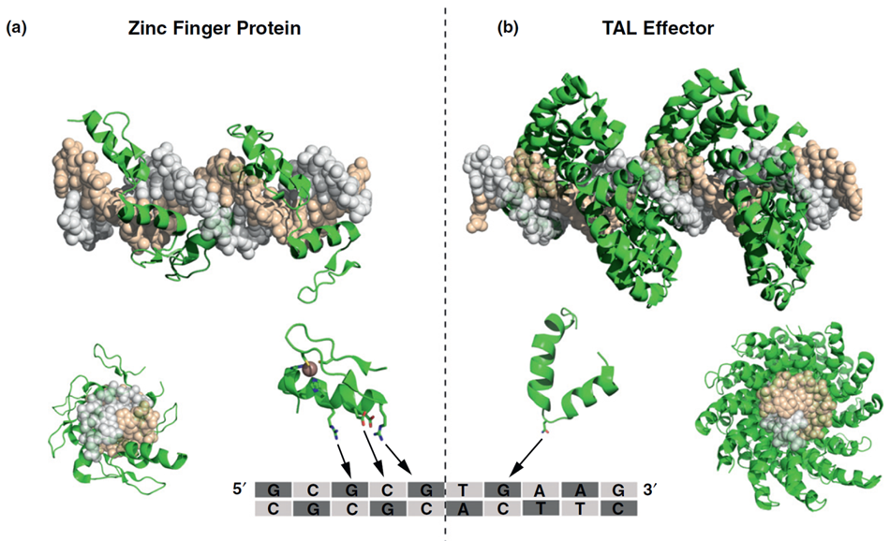
Programmable DNA binding modules
Zinc finger and TAL effector proteins
Perez-Pinera et al. (2012) Curr. Op. Chem. Biol. 16, 1-10

Slide 26
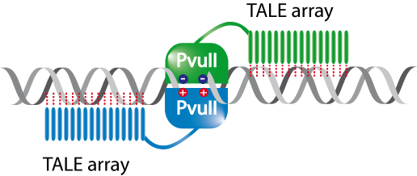
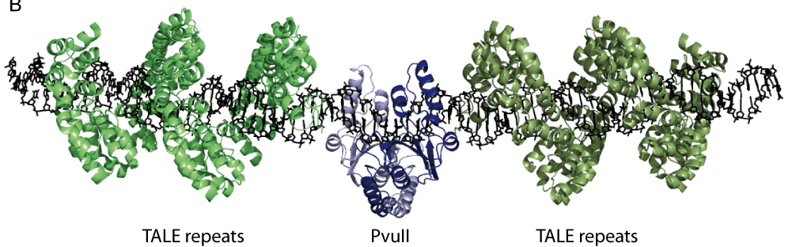
The architecture of TALE–PvuII fusion proteins
TALE-PvuII
Yanik, M., Alzubi, J., Lahaye, T., Cathomen, T., Pingoud, A. & Wende, W.
PvuII fusion proteins - novel tools for gene targeting
PlosOne in revision

Slide 27
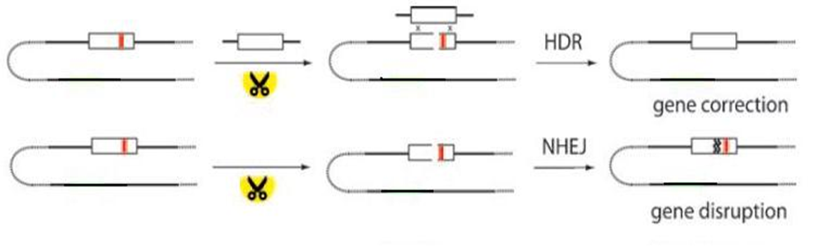
Replacing PvuII in TALE-PvuII by a nicking enzyme, e.g. MutH
„Nicking enzymes induced recombination events do not result in significant non-homologous end joining (NHEJ) events and appear to greatly reduce overall toxicity when the protein is expressed“
Chan SH, Stoddard BL, Xu SY (2011)
Natural and engineered nicking endonucleases--from cleavage mechanism to engineering of strand-specificity.
Nucleic Acids Res. 39, 1-18.
Modified after
Pingoud & Wende (2011) ChemBioChem 12, 1495 – 1500

Slide 28
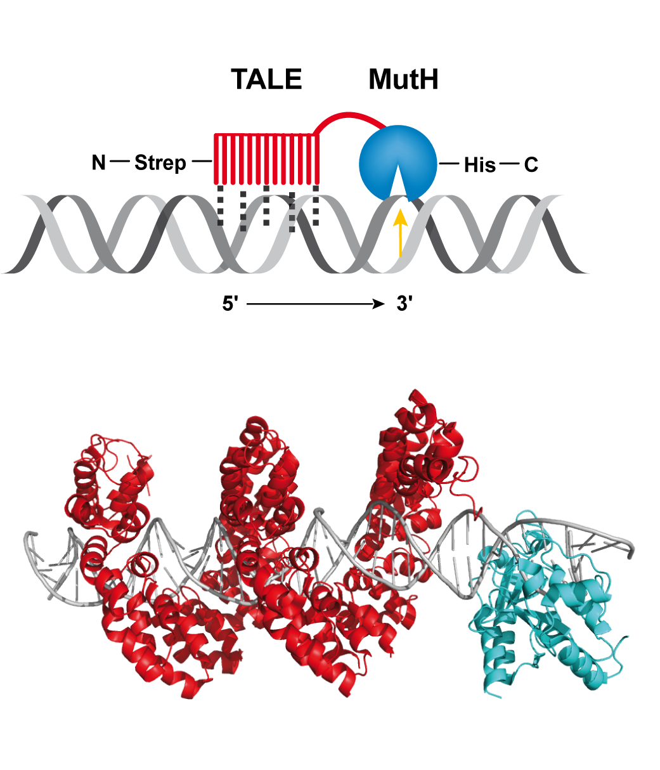
The architecture of TALE–MutH fusion proteins
mismatch repair endonuclease
Gabsalilow L, Schierling B, Friedhoff P, Pingoud A, Wende W.
Site- and strand-specific nicking of DNA by fusion proteins derived from MutH and I-SceI or TALE repeats.
Nucleic Acids Res. 2013;41(7):e83

Slide 29
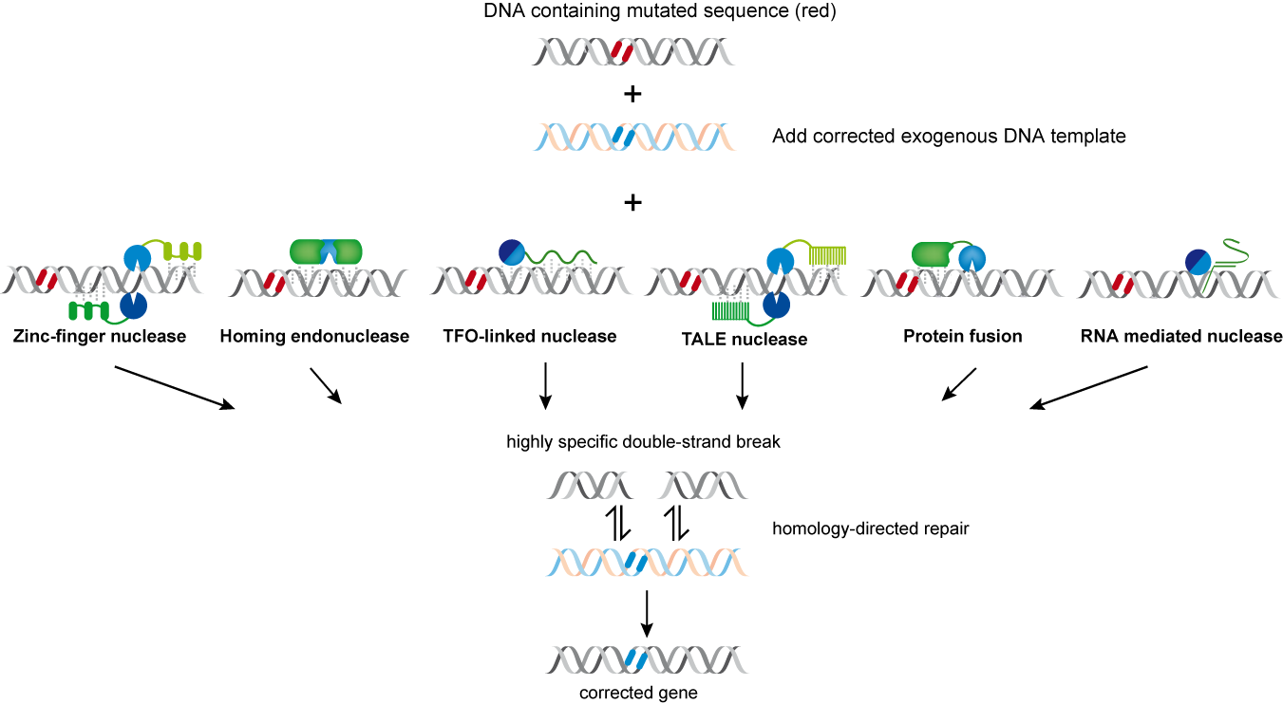
Engineered nucleases: „the tool box“
Modified after
Pingoud A & Silva GH (2007)
Precision genome surgery
Nat Biotechnol. 25, 743-4

Slide 30

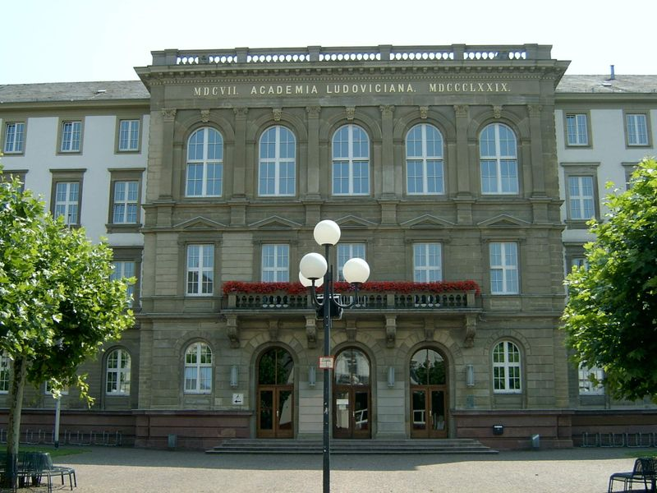
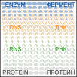


Acknowledgements
Coworkers, colleagues:
Fabian Bietz
Bedriska Reitz
Kristin Eisenschmidt
Ines Fonfara
Michael Foss
Peter Friedhoff
Lilia Gabsalilow
Eva Günther
Nicolas Martin
Marika Midon
Ann-Josée Noël
Benno Schierling
George Silva
Sabrina Stiehler
Laura Waltl
Wolfgang Wende
Mert Yanik
Collaborators:
Hien Le Thi
Eugeny Volkov
Elena Kubareva
Tatjana Oretskaya
Moscow State University
Oleg Gimadutdinov
Kasan State University
Michael Kokkinidis
University of Crete, Heraklion
Toni Cathomen
Universitätsklinikum Freiburg
Thomas Lahaye
Eberhard-Karls-University, Tübingen
Andreas Römpp
Berhard Spengler
“International Research Training Groups”
(grant RFBR-DFG 08-04-91974)

