Slide 1
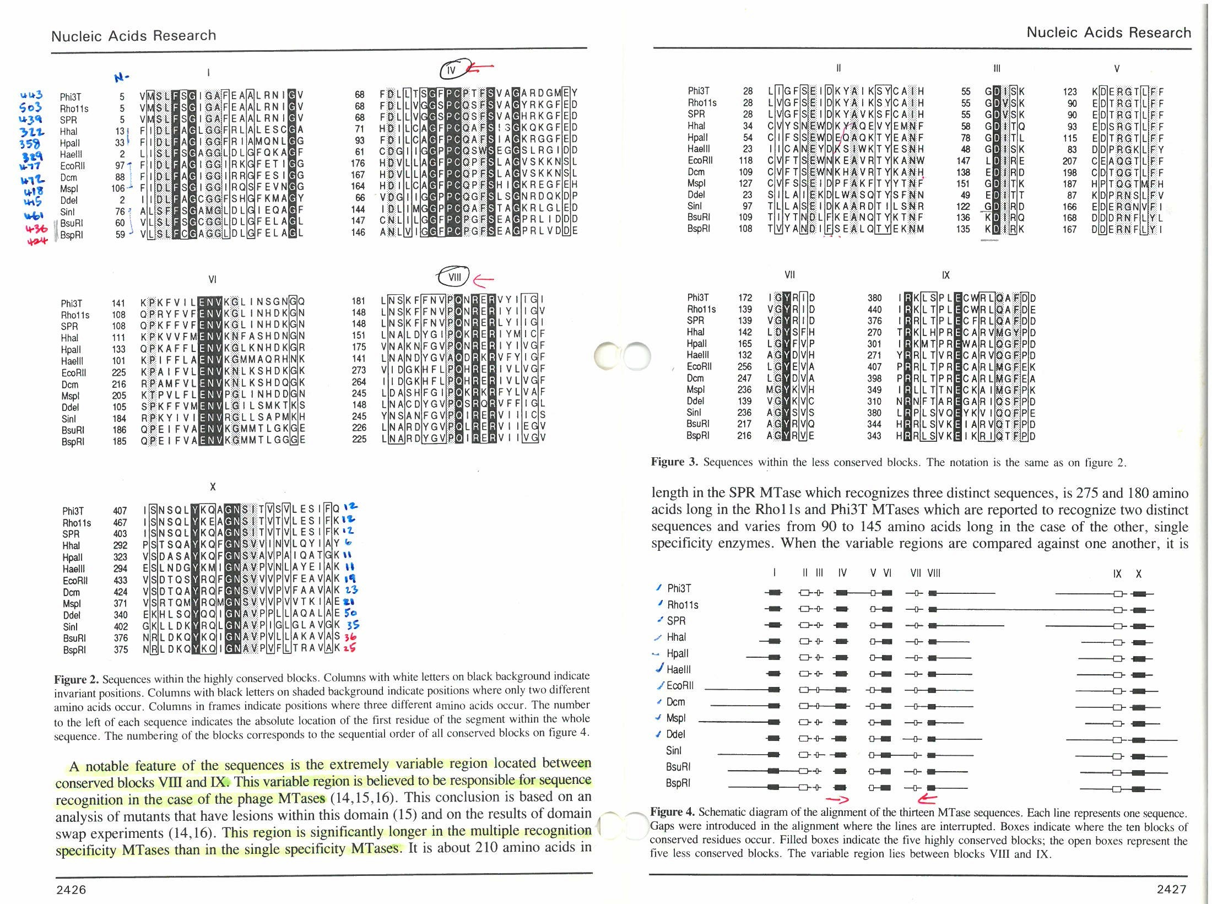
My Journey with RM systems

Slide 2

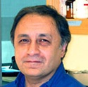
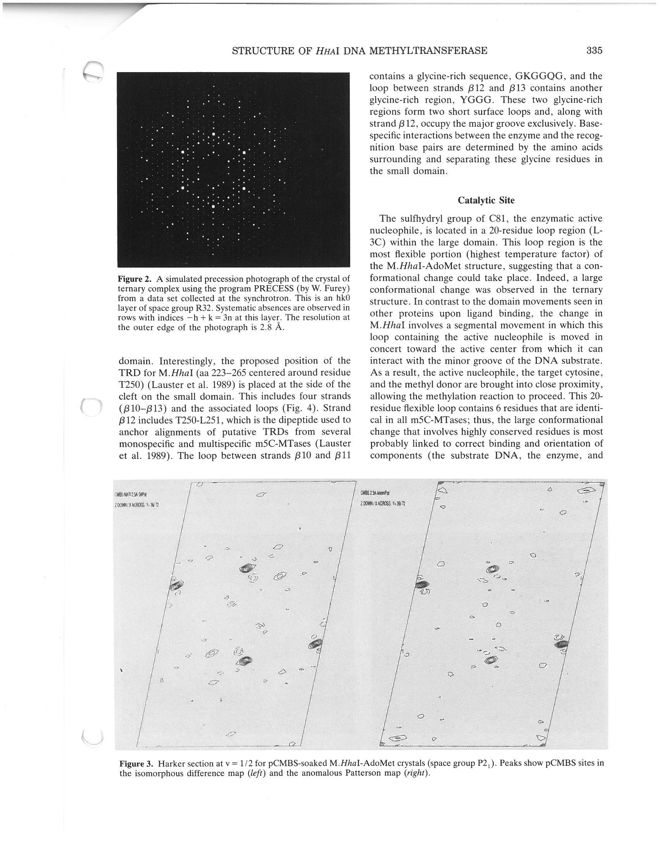
M.SssI – Mi Sha

Slide 3

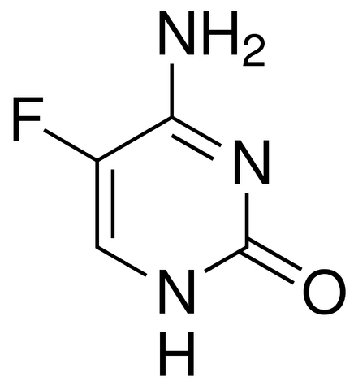
5-fluorocytosine

Slide 4
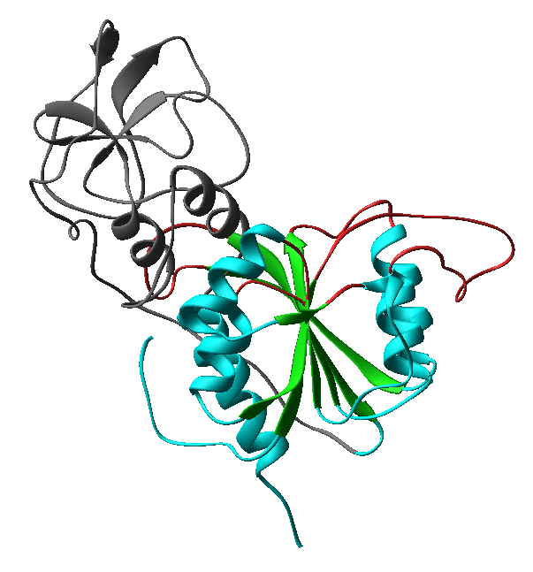
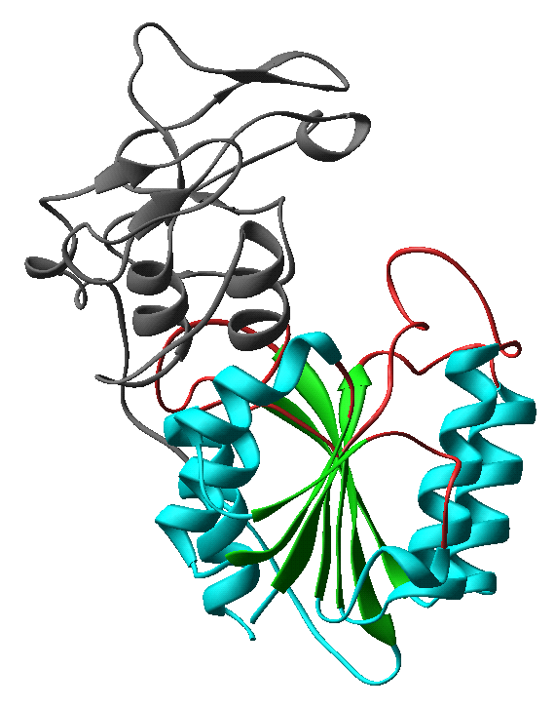
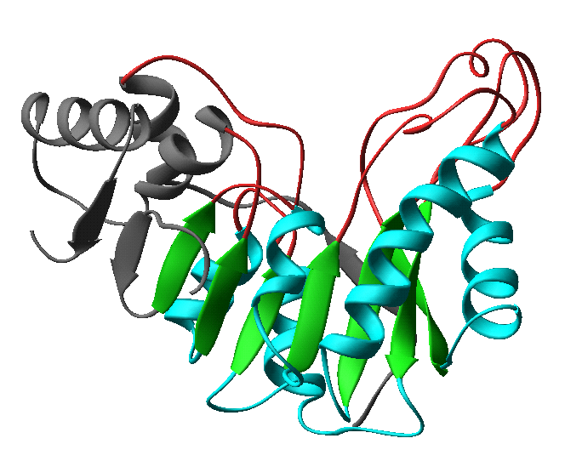
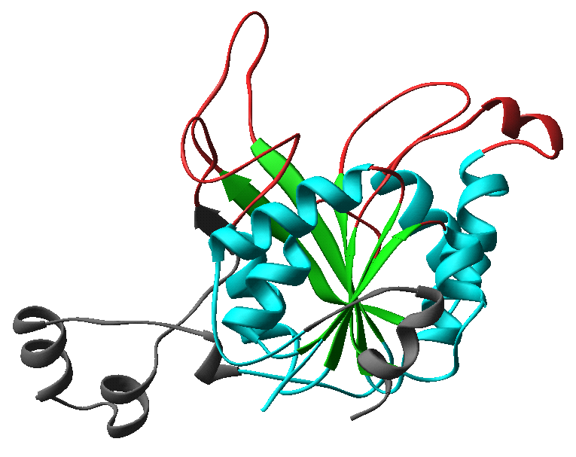
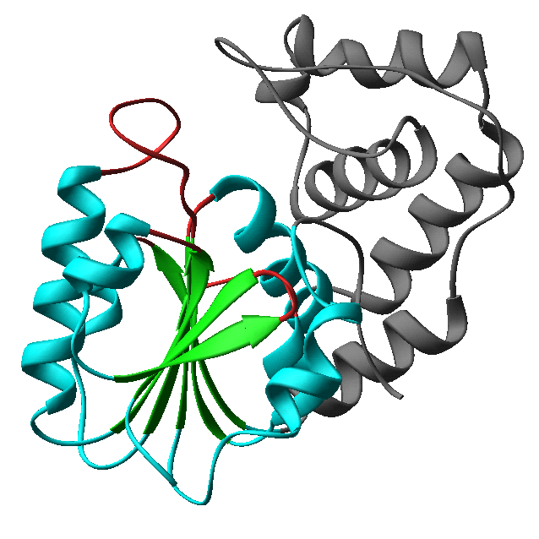
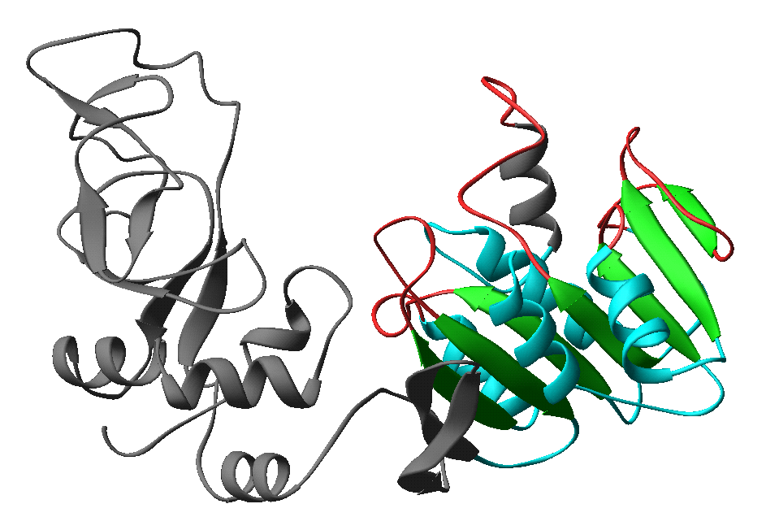
Examples of DNA MTases
HhaI (C5) HaeIII (C5) PvuII (N4)
DpnII (N6) RsrI (N6) TaqI (N6)

Slide 5
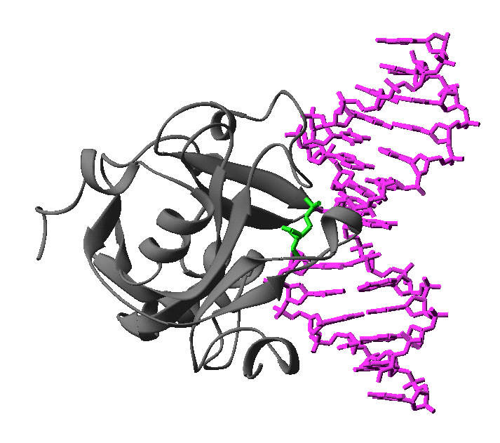
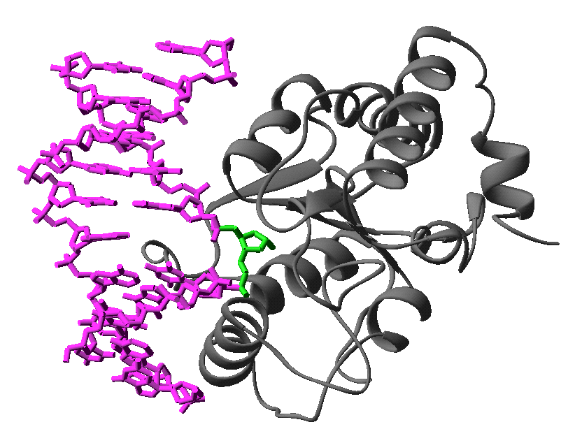
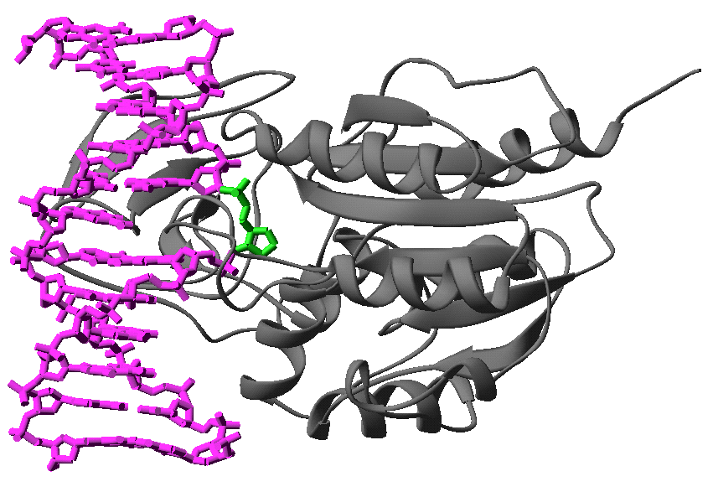
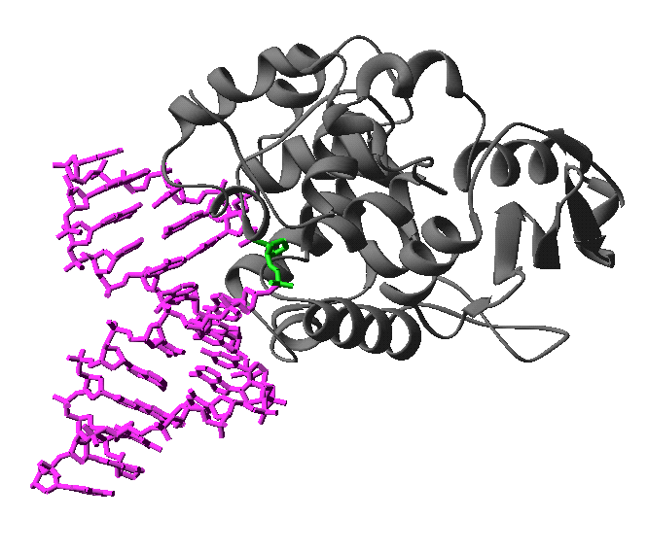
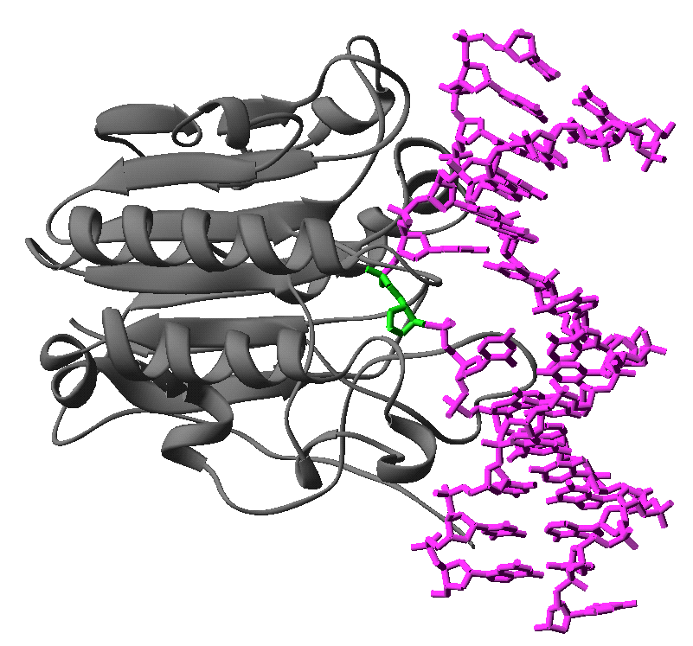
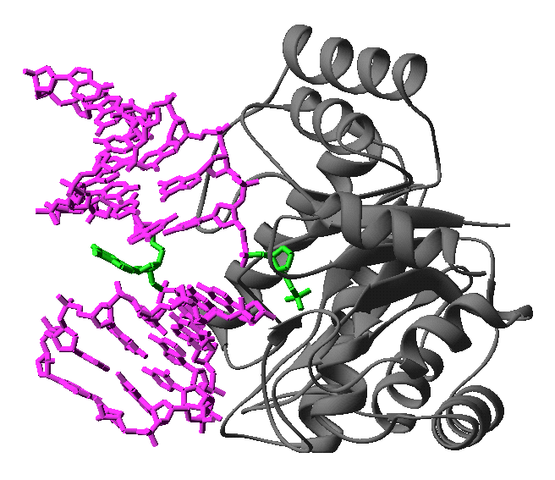
Examples of Base Flipping Enzymes
(A) HhaI (B) UDG (C) AAG
(D) EndoIV (E) AlkA (F) HAP1

Slide 6

Mechanistic link between DNA MTases and DNA repair Enzymes

Slide 7

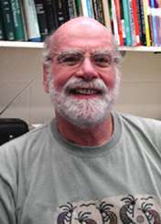

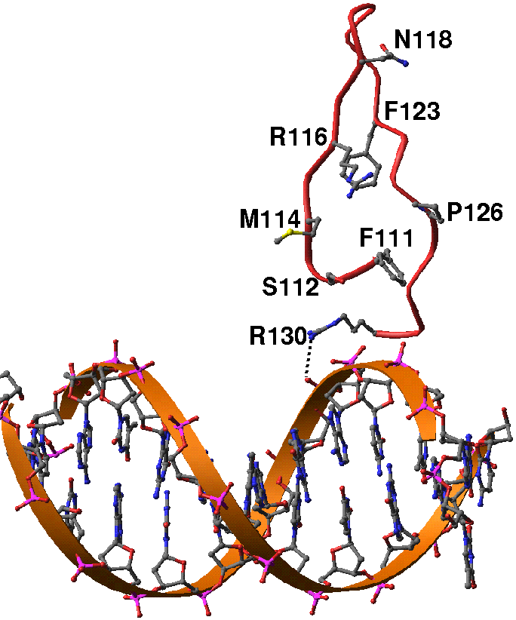
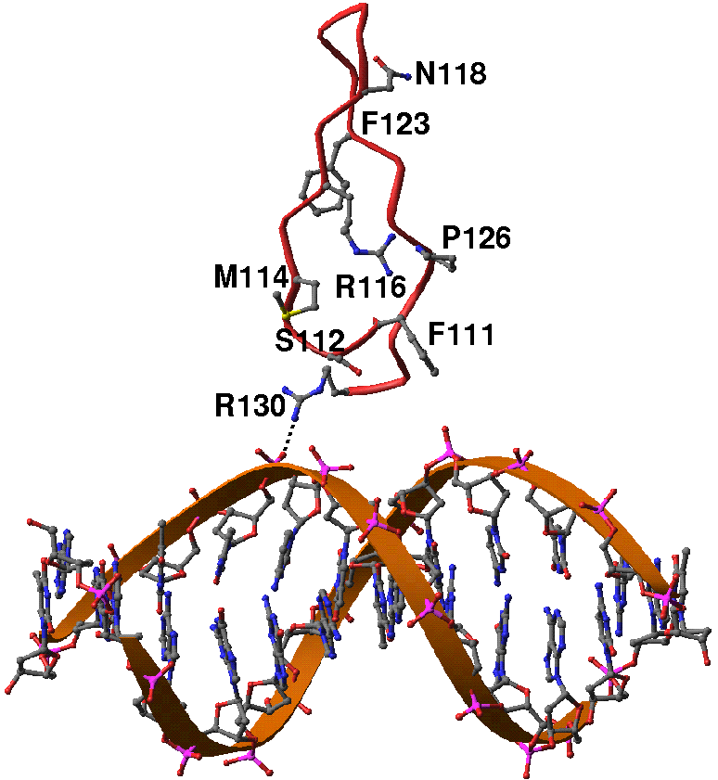
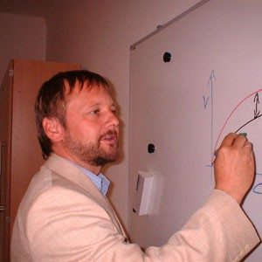
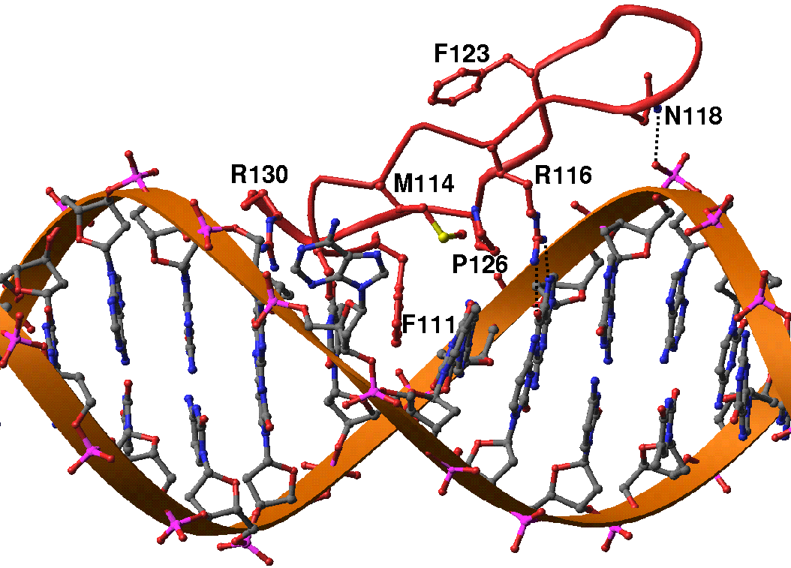
John R. Horton

Slide 8


Slide 9
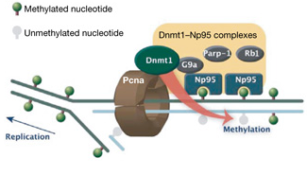
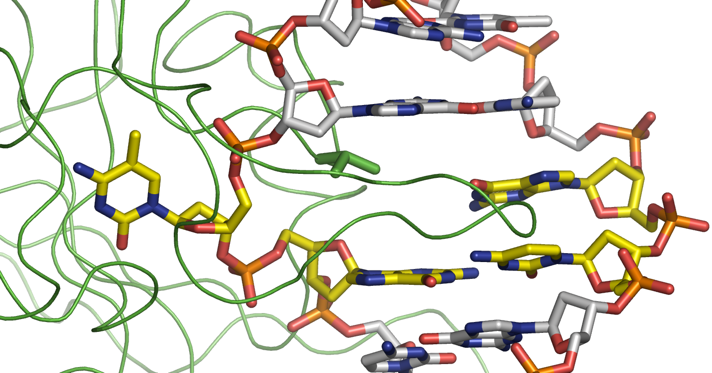
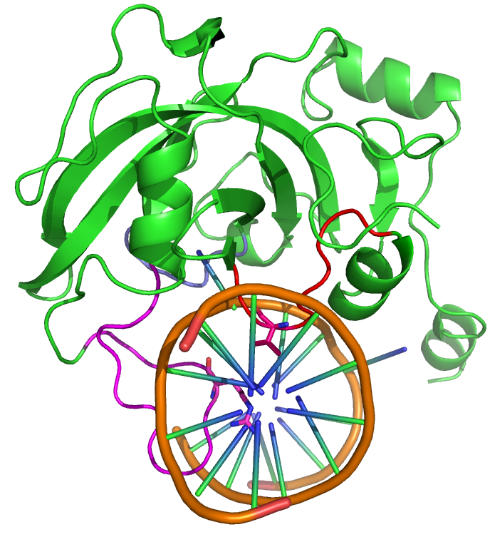
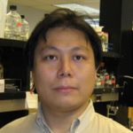
UHRF1/NP95
Both UHRF1 and DNMT1 are required for maintenance methylation of hemimethylated CpG dinucleotides at DNA replication forks - the key to faithful mitotic inheritance of genomic methylation patterns.
H3K9me3 H3R2me0
UHRF1
UBL
Tudor
PHD
Set and Ring Associated (SRA) domain
RING
Hideharu Hashimoto

Slide 10
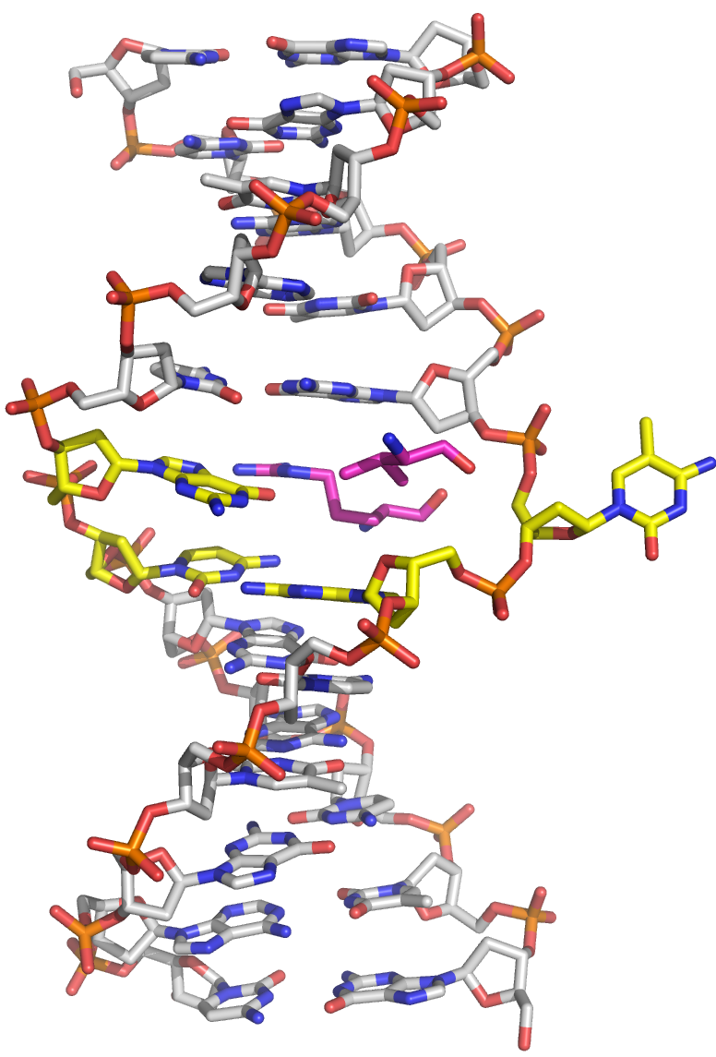
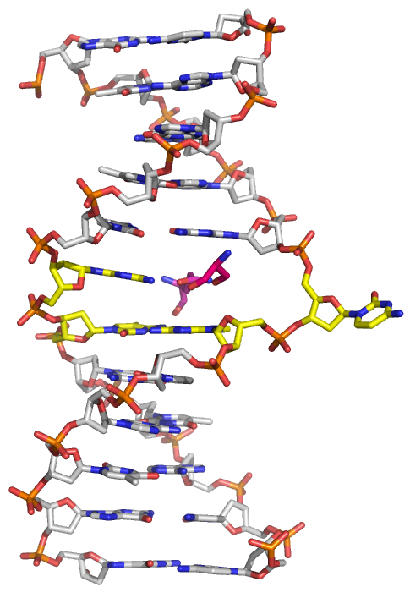
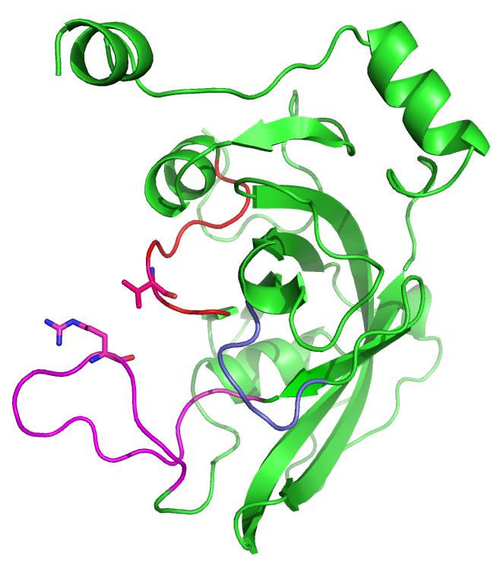
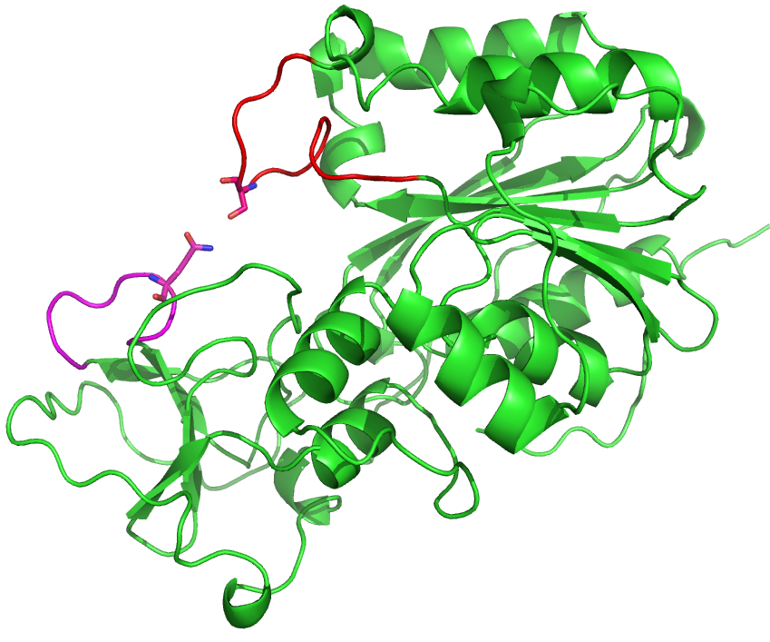
Base flipping
SRA-DNA
HhaI-DNA
Hashimoto et al. (2008) Klimasauskas et al. (1994)

Slide 11
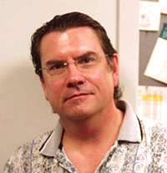
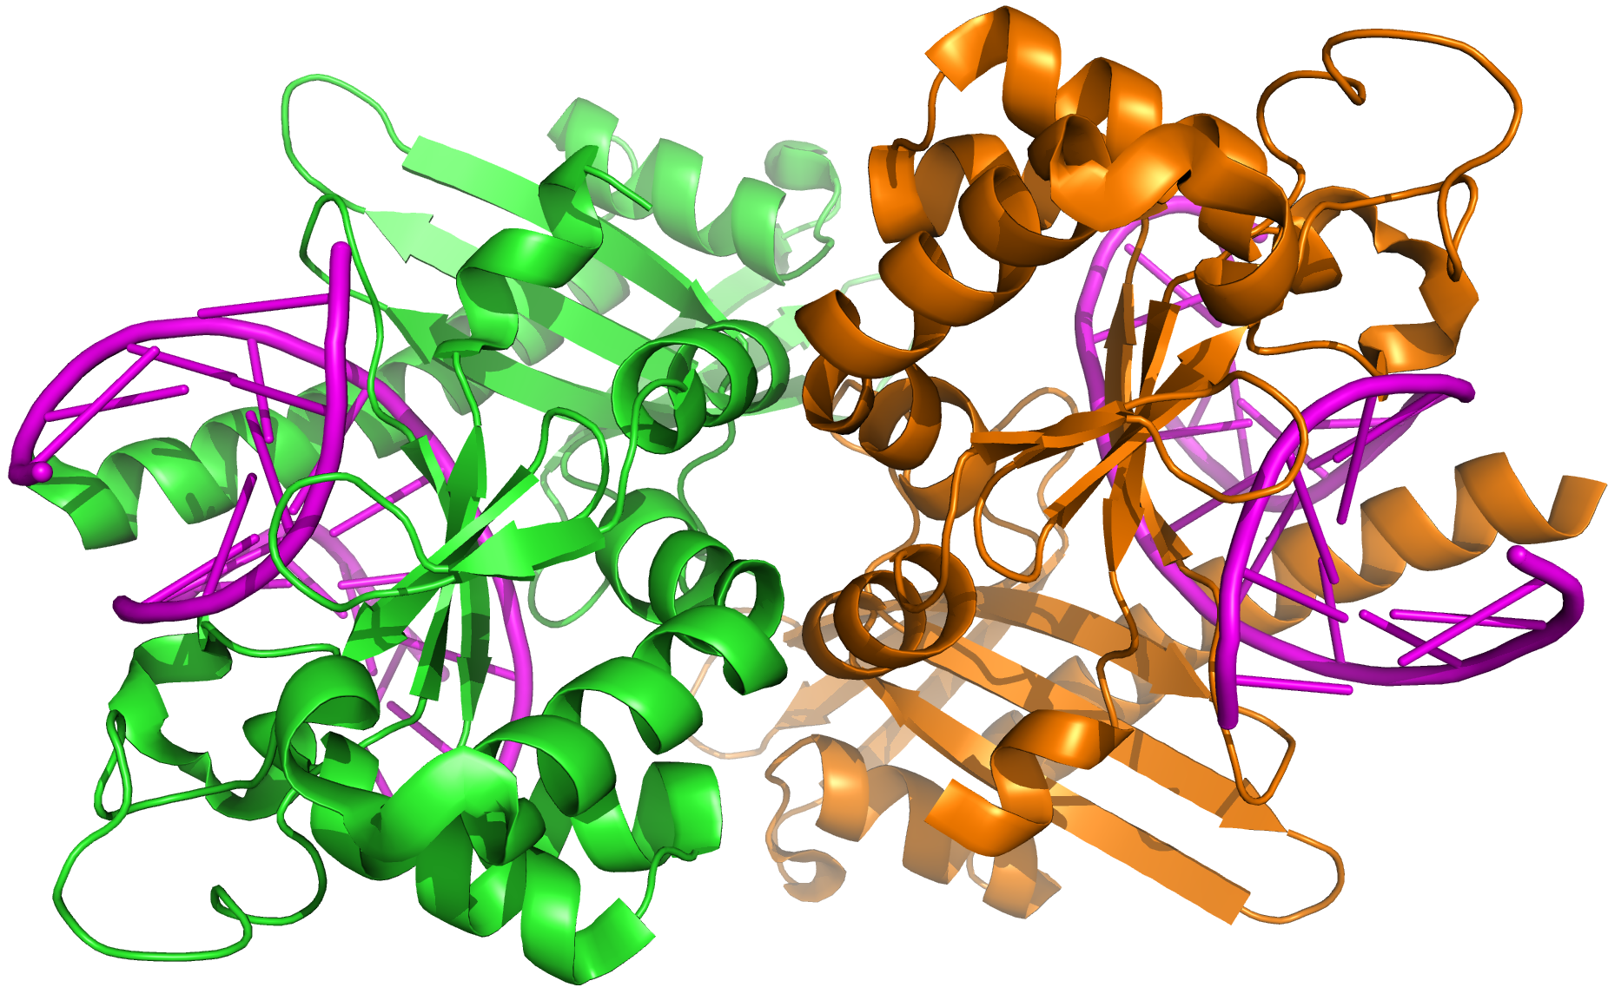
Face-to-Face dimer
Back-to-Back dimer

Slide 12
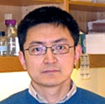
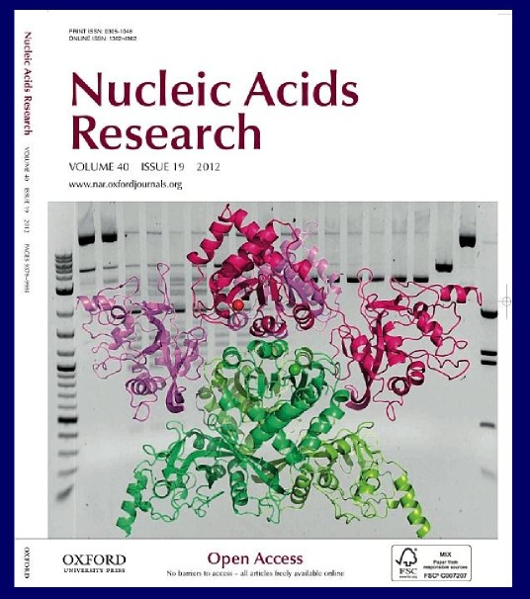
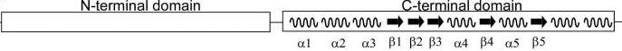
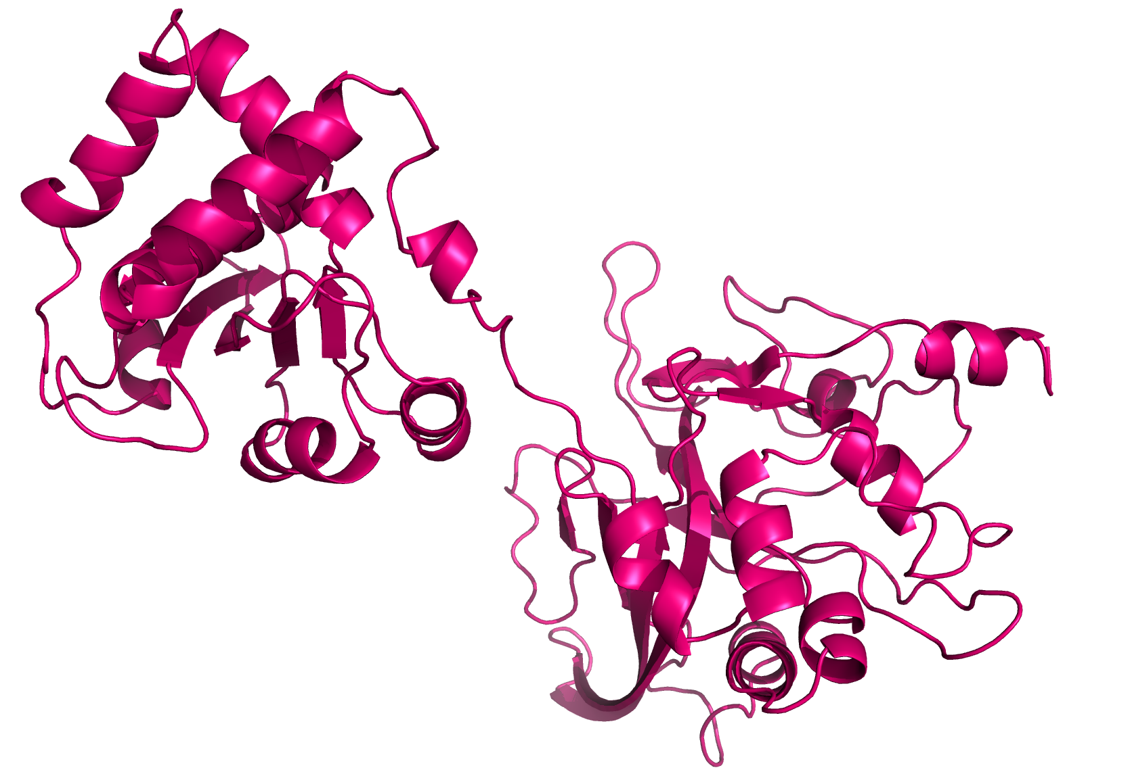
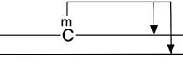
DNA binding domain
5’
12
3’
3’
16
5’
Equal activity on 5mC and 5hmC, but not 5gmC

Slide 13
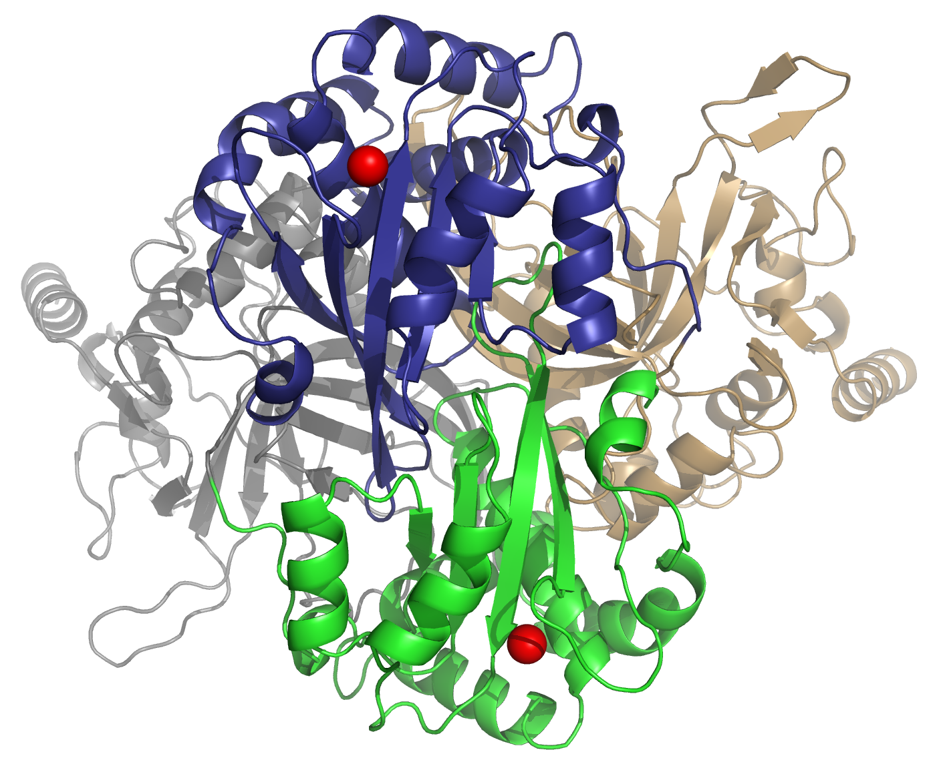
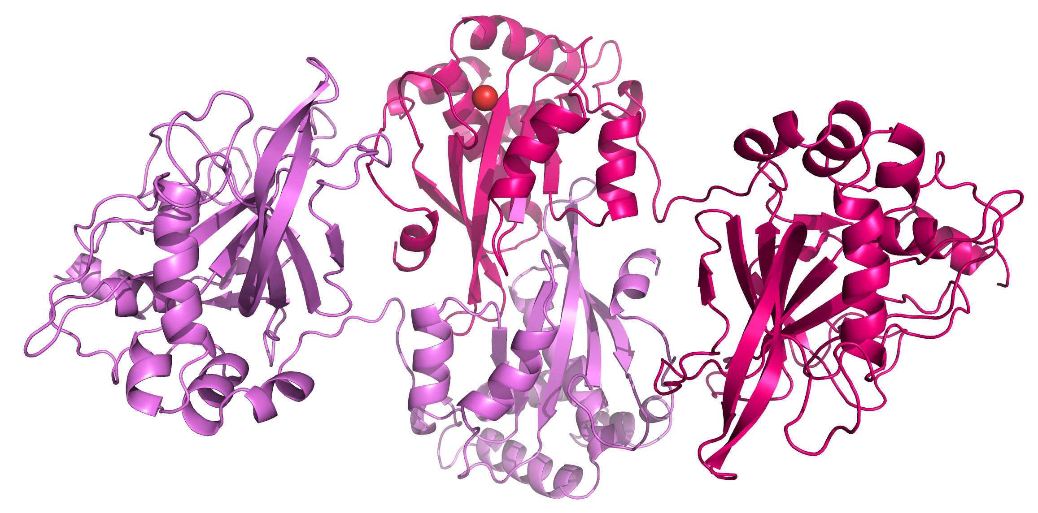
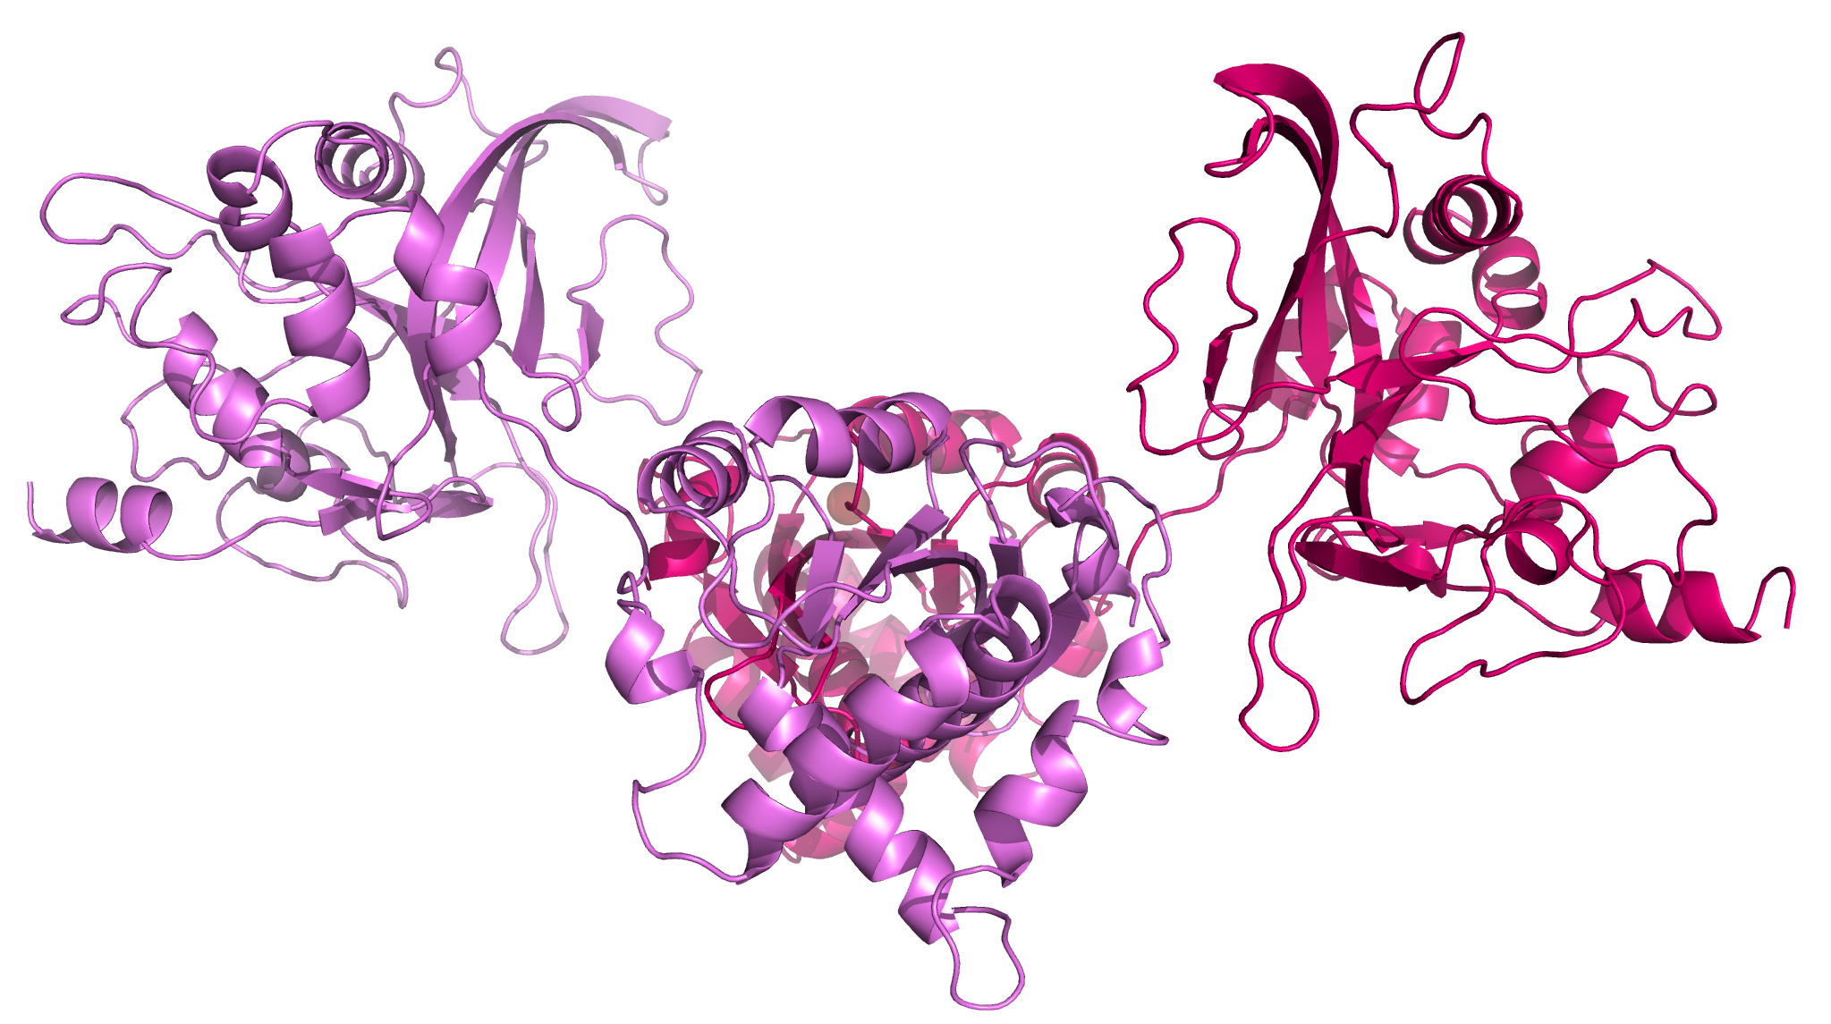
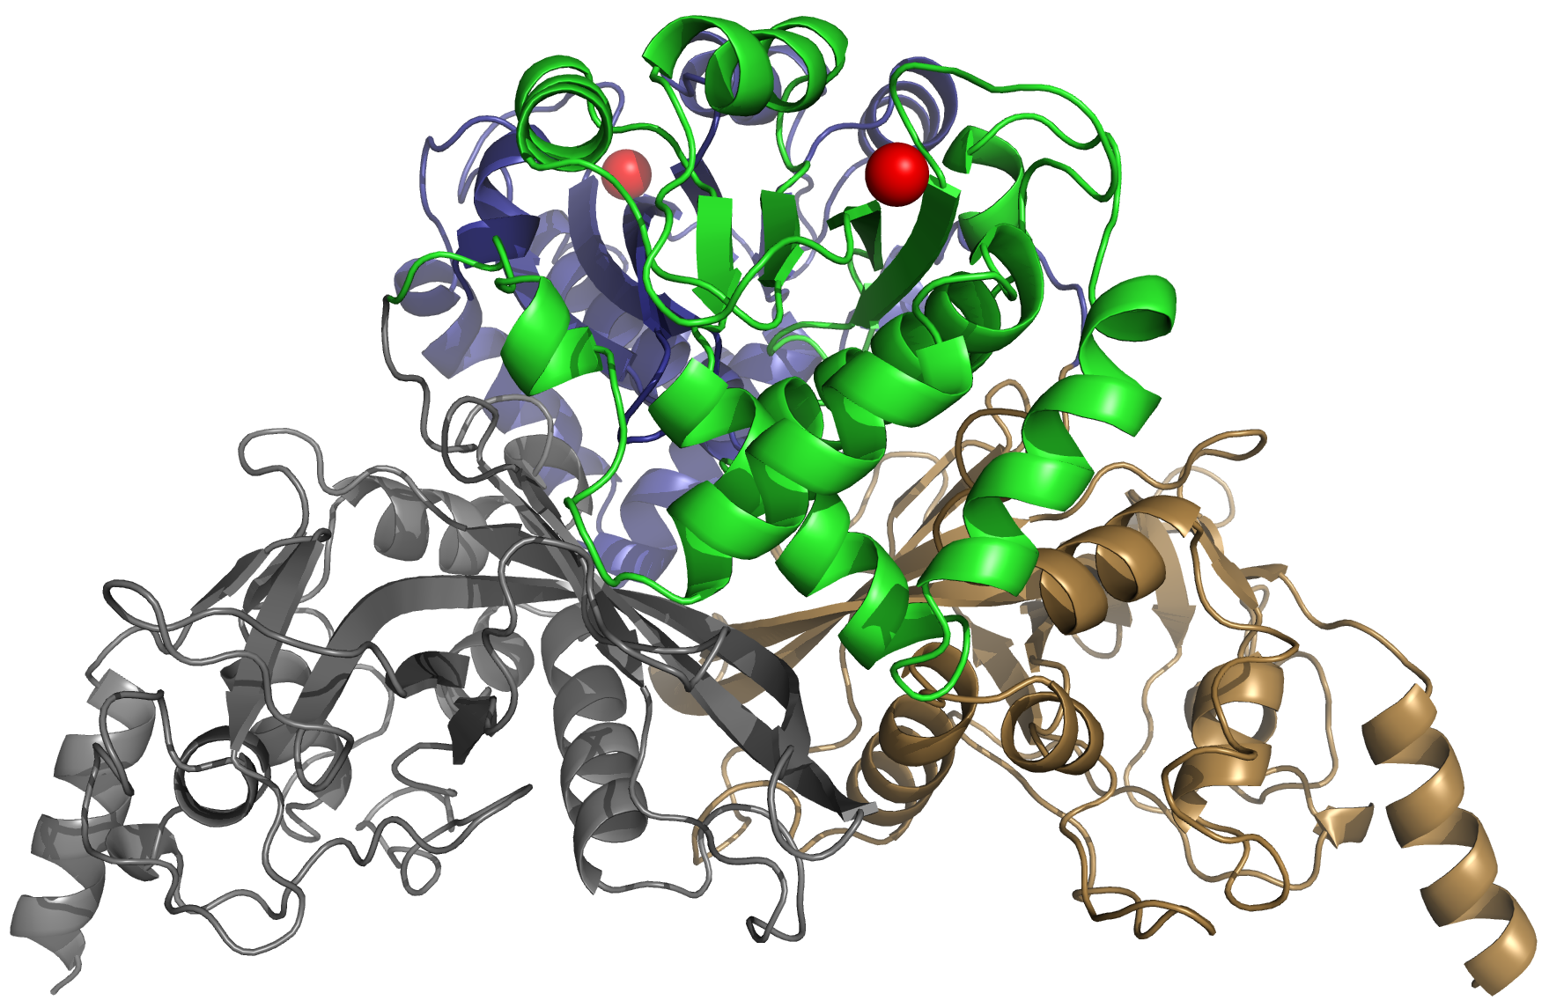
Two Back-to-Back dimers
Mg²⁺
Mg²⁺
(top view)
Mg²⁺
SRA-like domain
SRA-like domain
Open dimer
Closed dimer
endonuclease
domain
N
N
N
(side view)
N

Slide 14
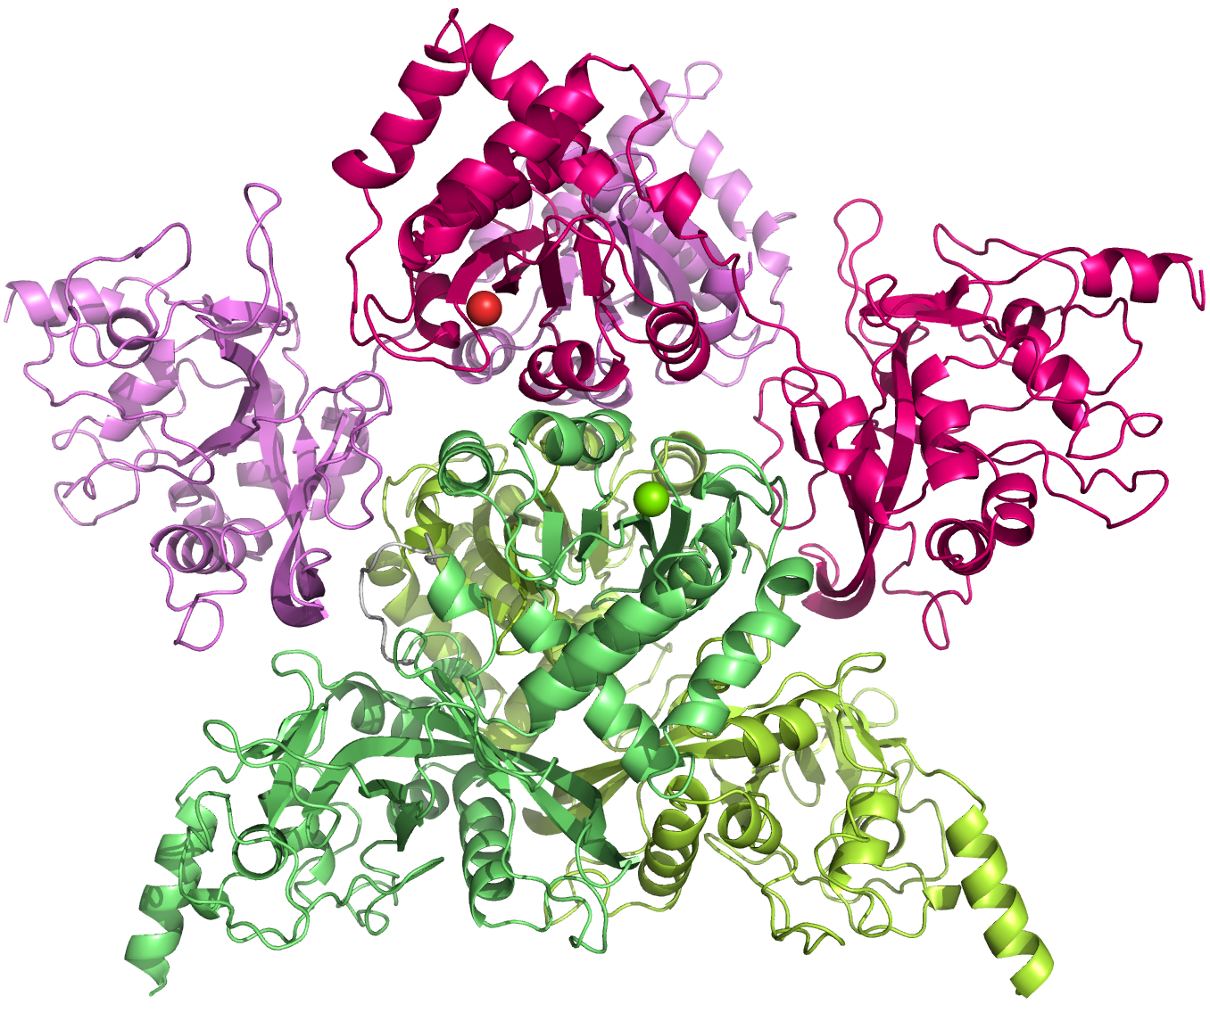
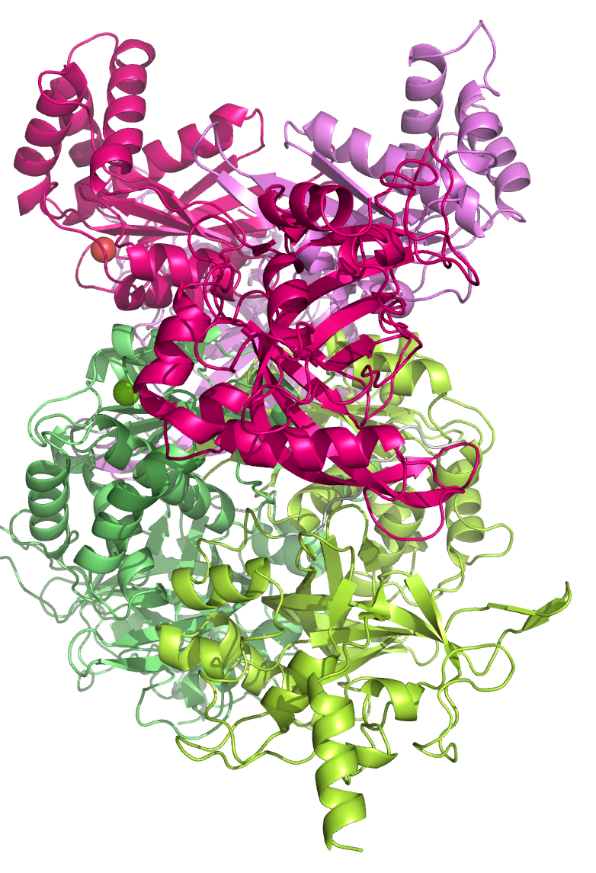
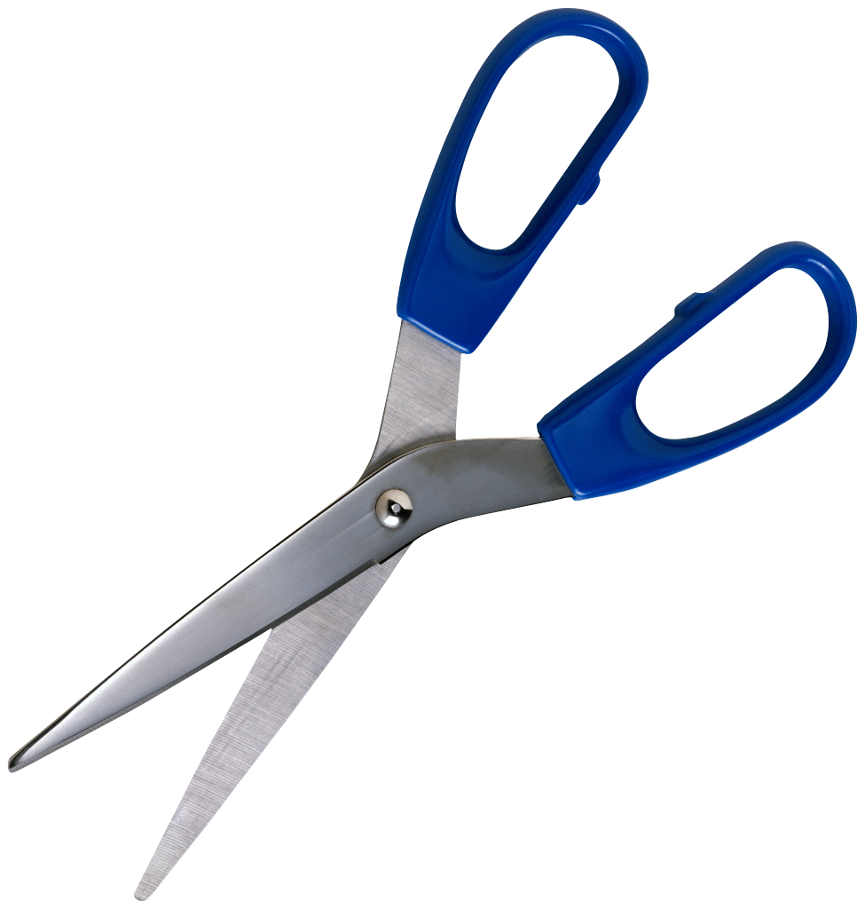
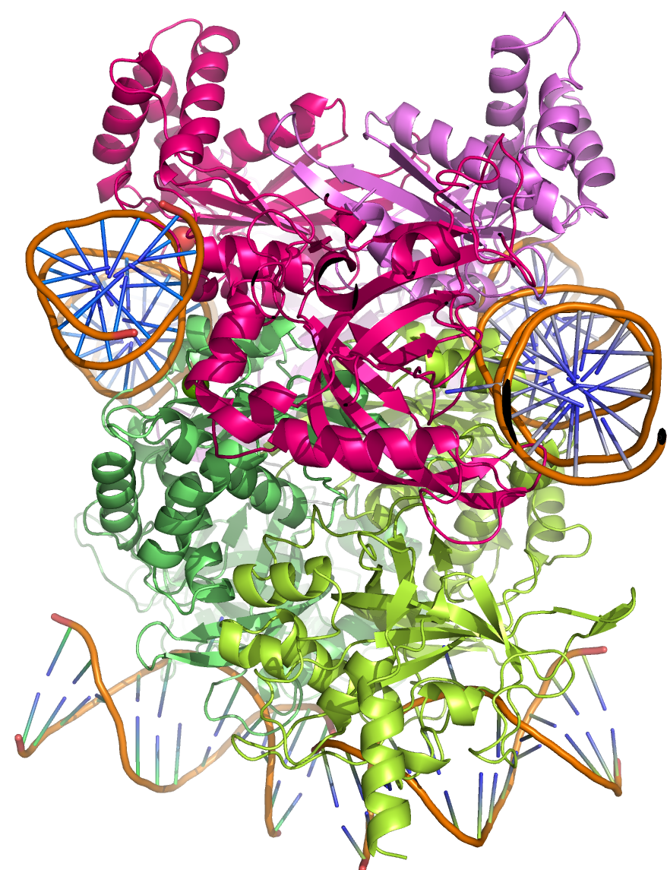
Open dimer
Mg²⁺
Open dimer
Mg²⁺
Mg²⁺
Closed dimer
N
N
optimum
activity
stalled activity
no activity

Slide 15
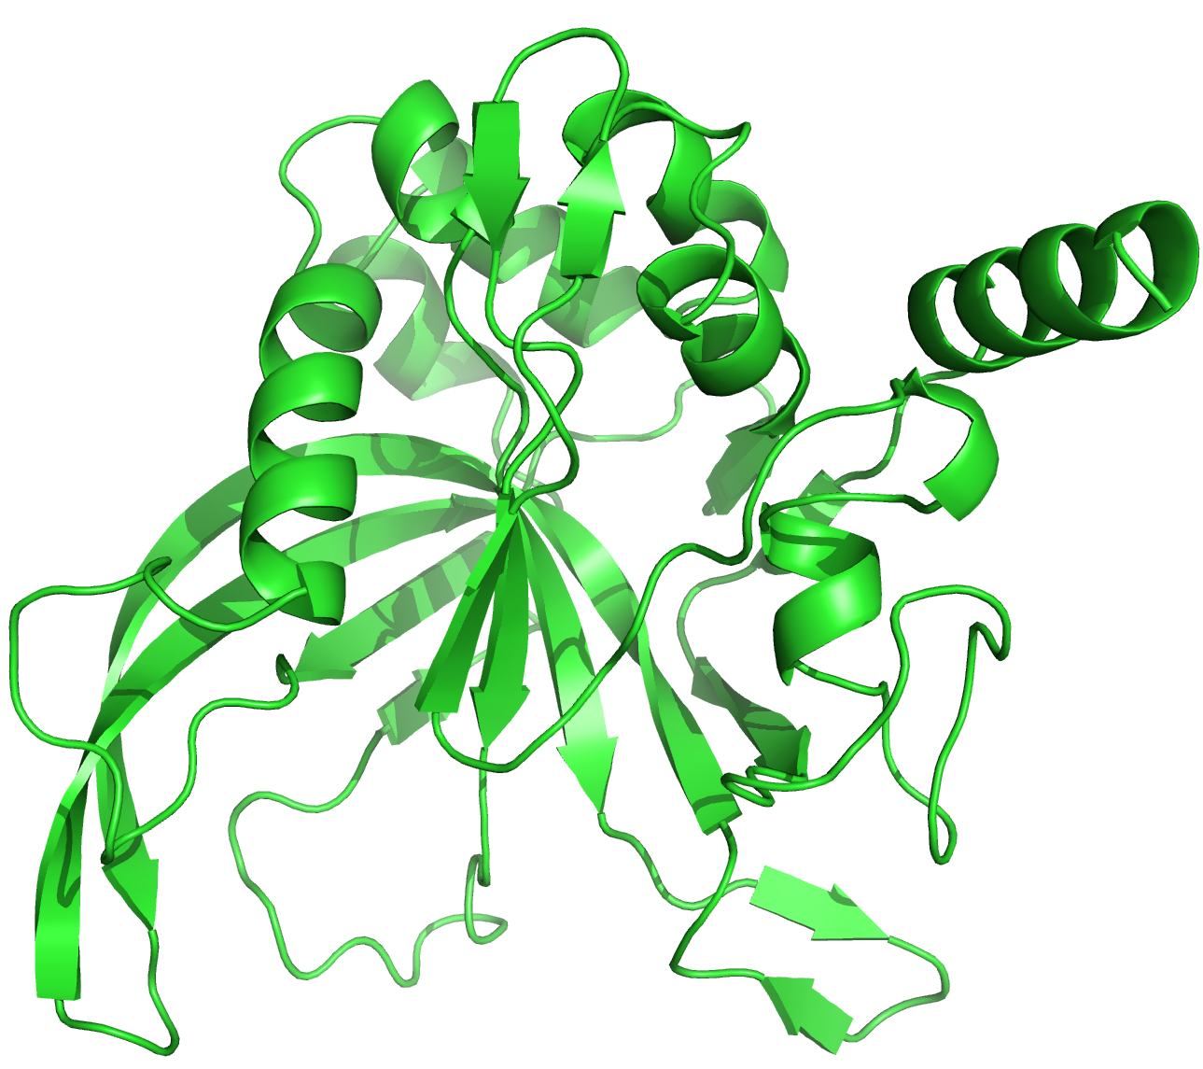
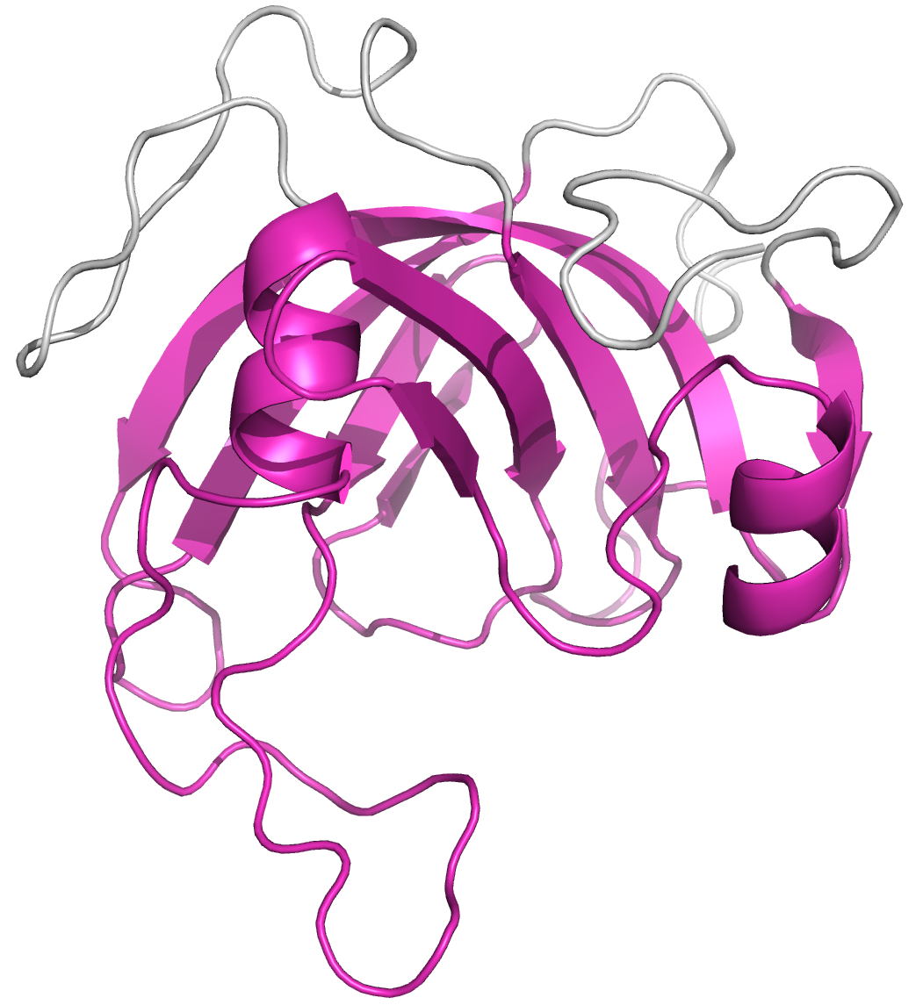

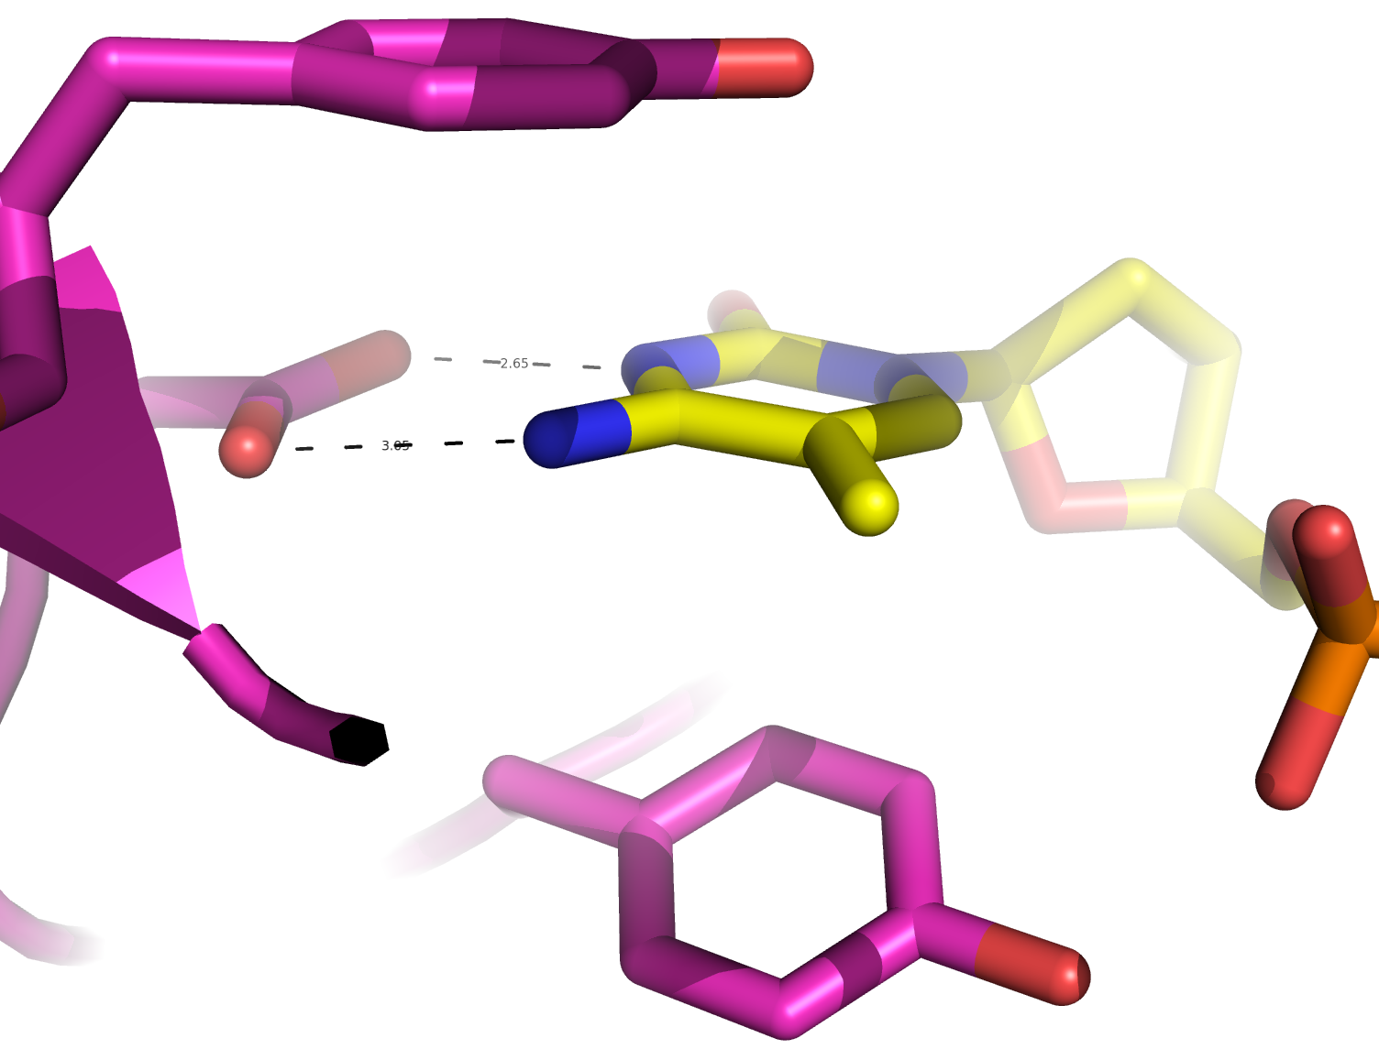
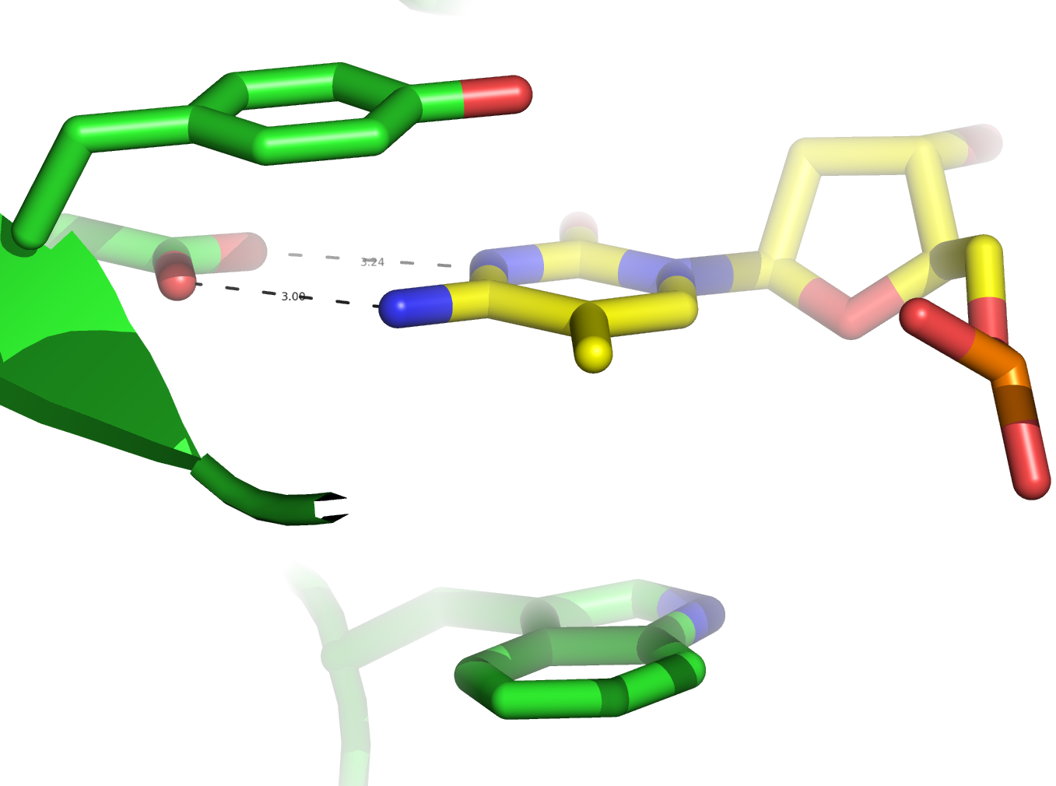
UHRF1 (SRA)
MspJI-N
A
C
C
7
8
2
10
1
8
6
4
8
3
9
5
B
6
B
9
*
3
4
7
Y114
5
8
2
*
D103
Y
Y
D
5mC
5mC
6
D
6
W
Y

Slide 16
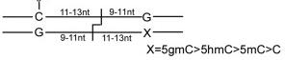

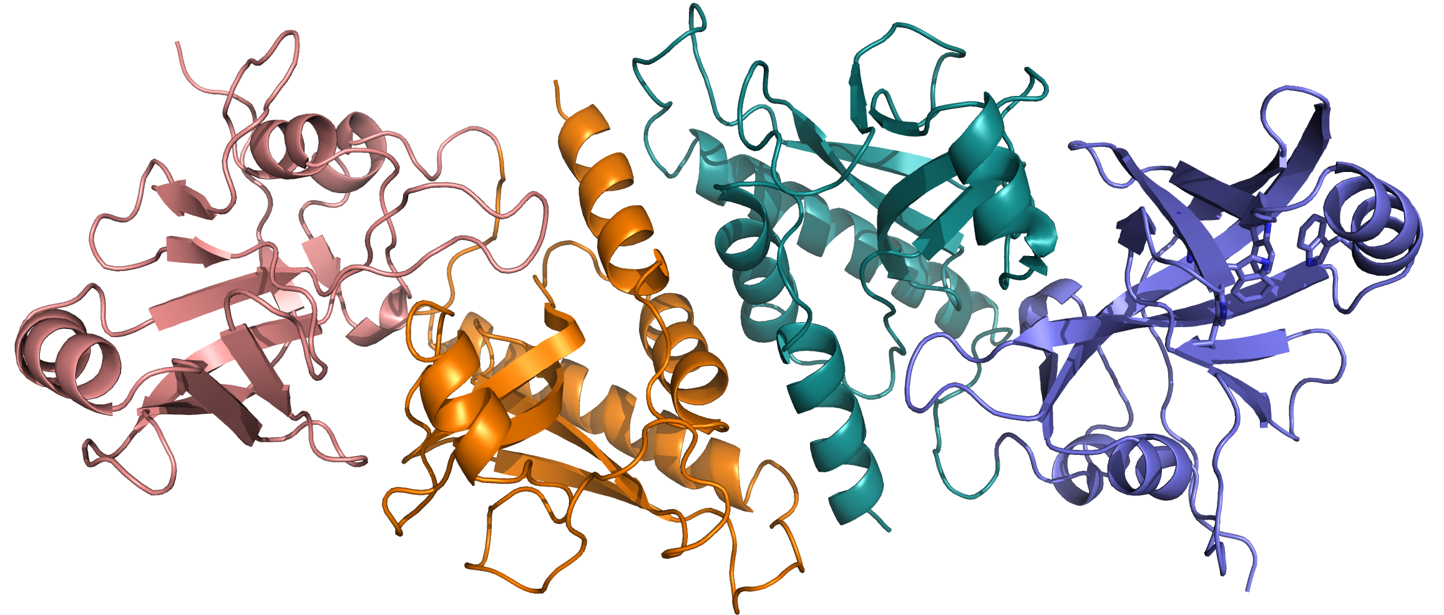

5gmC or 5hmC
*
(b)
8000 : 500 : 1
AbaSI of Acinetobacter baumannii SDF
Homing Endonuclease
DNA recognition
Homing endonuclease dimer
7
9
4
2
8
6
B
5
3
C
*
8
E
*
N
*
W
DNA-binding
DNA-binding

